Slide 1





Export Documentation Compliance
Getting to
March 22, 2018 2:00pm EDT
For sound, ensure speakers are on
and the system has not been muted
Please be sure to disable any pop-up
blocking software
If you experience technical problems during
the webinar please let us know via the questions box
Notes:
PLACEHOLDER PAGE ONLY – PLACEHOLDER FOR START OF WEBINAR.

Slide 2
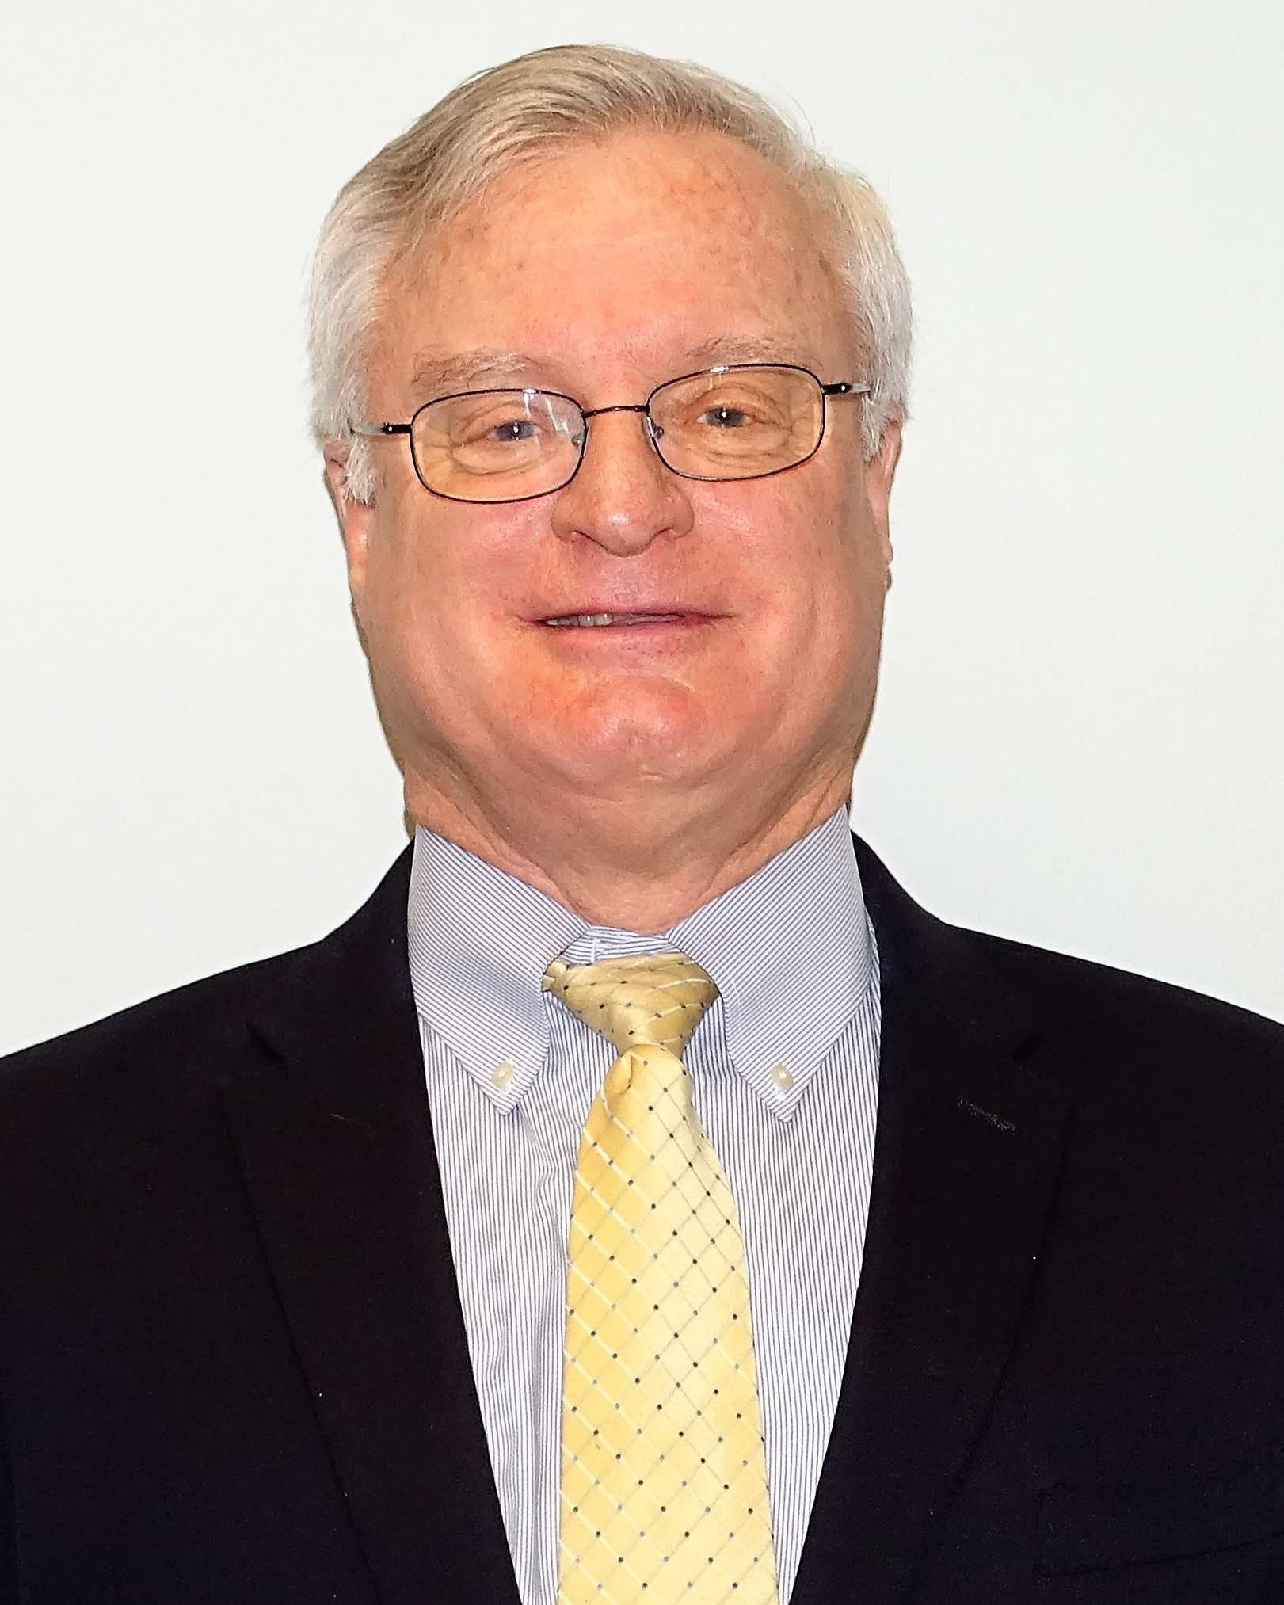







Meet The Speakers
Michael J. Ryan
Executive Vice President
Preferred Shipping
Adam N. Young
Senior Vice President
Preferred Shipping
Eric A. Miller
Regional Director
Greater Houston Office
Export-Import Bank
of the U.S.

Slide 3
Michael J. Ryan
Executive Vice President
Preferred Shipping
michael.ryan@preferredship.com
708-224-1498 mobile
Adam N. Young
Senior Vice President
Preferred Shipping
adam@preferredship.com
713-851-9133- mobile

Slide 4

AGENDA
Five Key Elements to ensuring Document Accuracy
Logistics Planning for International Markets
Protecting Against Nonpayment
Competitive Positioning with Credit Enhancement

Slide 5
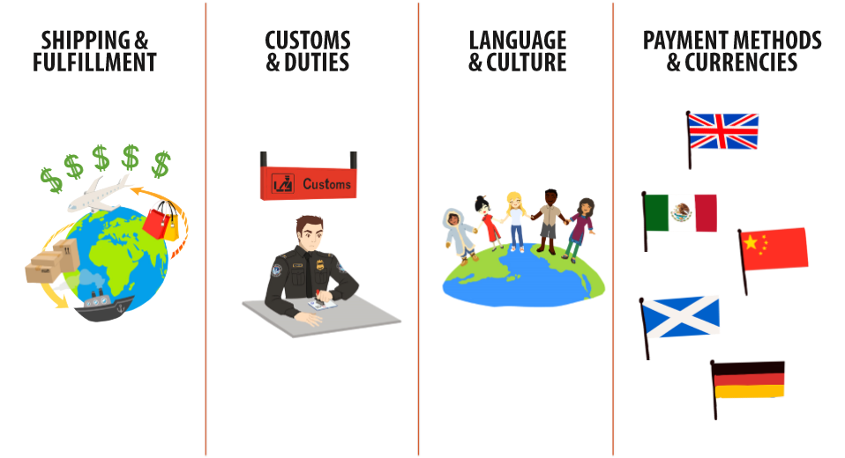
COMPLEXITIES OF GLOBAL E-COMMERCE

Slide 6
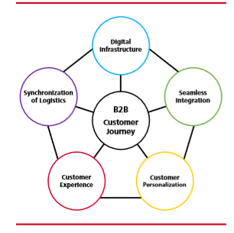
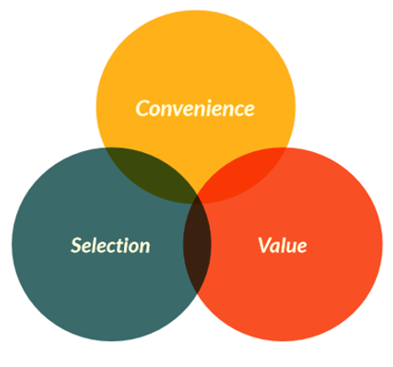
CUSTOMER EXPERIENCE (CX)
Customer Experience
Customer Journey

Slide 7

AUDIENCE POLL
What problems do you experience the most with international orders?
Satisfying delivery expectations
Customs delays
Slow payment
Poor export paperwork
Cultural knowledge

Slide 8
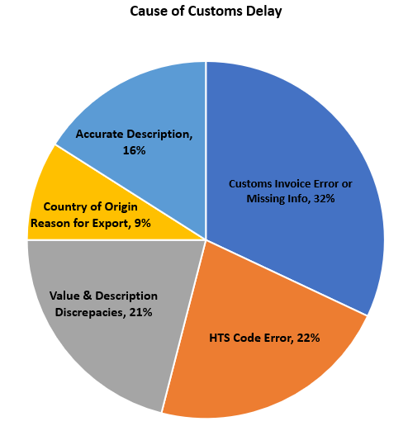
5 KEY ELEMENT TO ENSURING DOCUMENT ACCURACY
Commercial or Proforma Invoice
HTS Code - The Universal Language
Value & Description of Commodity
Country of Origin & Reason for Export or Import
Accurate Description of the Commodity

Slide 9
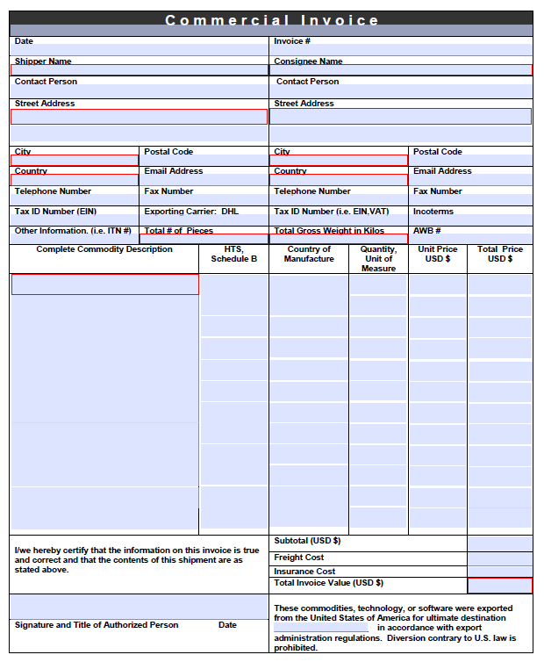
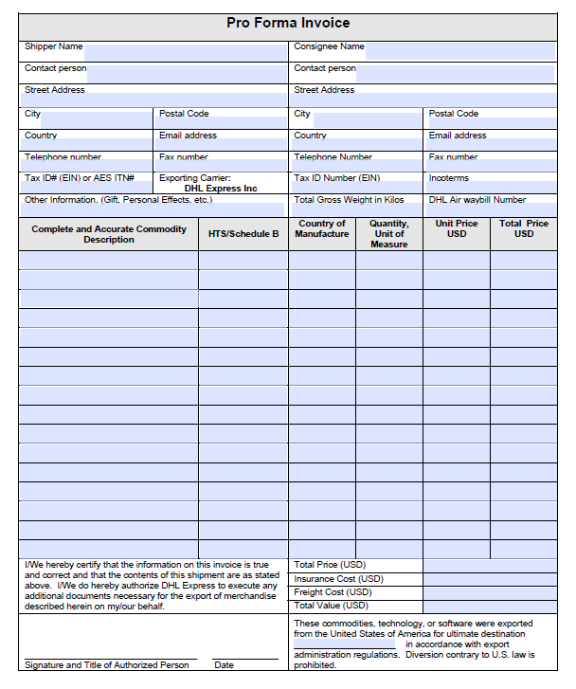
COMMERCIAL OR PRO FORMA INVOICE
Required on all Commodity
Shipments
What is the Difference?
Not All Countries Permit the Use
of a Pro forma Invoice
Proper Customs Invoice Format

Slide 10
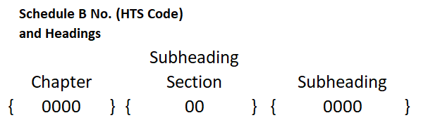
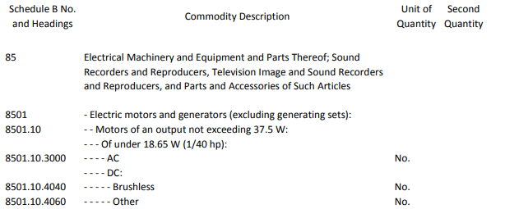
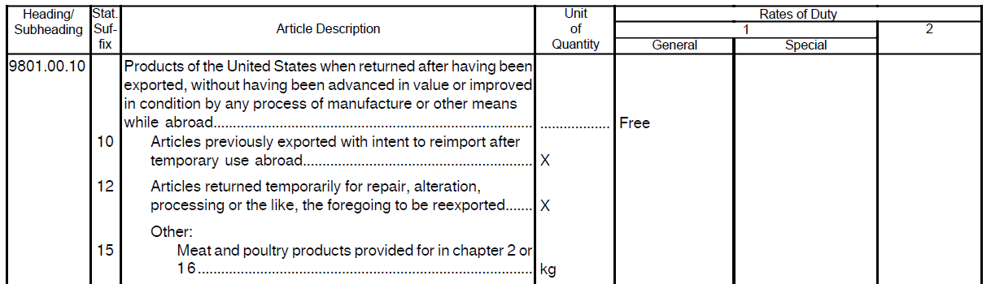
HTS CODE: THE UNIVERSAL LANGUAGE
The Universal Language
Use ALL 10 digits
Special Situations

Slide 11

VALUE & DESCRIPTION OF COMMODITY
Customs Invoice Must Have a Value
Repairs, Returns, Replacements
Part Numbers Don’t Mean Anything to Customs
Specific Description (AWB vs CI)
Additional Verbiage

Slide 12
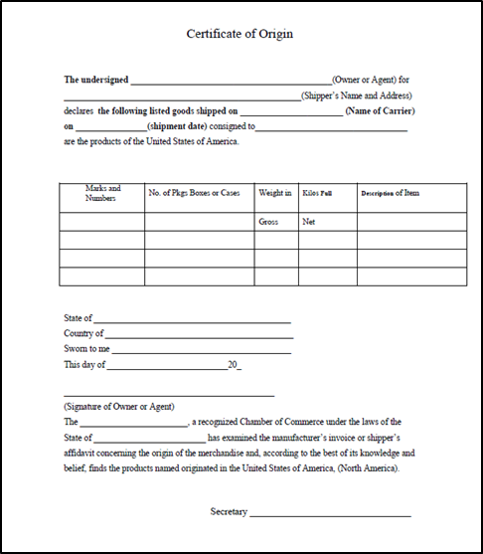
COUNTRY OF ORIGIN & REASON FOR EXPORT OR IMPORT
Influences The Rates of Duty
Certificate of Origin
Permanent or Temporary

Slide 13

LOGISTICS PLANNING FOR INTERNATIONAL MARKETS
Commodity Restrictions, Prohibitions and Requirements
Value Limits & De Minimis Value
Customs Broker
Free Trade Agreements

Slide 14


Commodity Restrictions, Prohibitions and Requirements
Know the Destination Country Restrictions & Prohibitions
Documentation Requirements
Quantity Restriction
Permits & Licenses

Slide 15
REFERENCE LINKS
U.S. Census Bureau: https://www.census.gov/foreign-trade/schedules/b/index.html
Basic Guide to Exporting: www.export.gov/basicguide/
Country Commercial Guides: www.export.gov/ccg/
Preferred Shipping: www.preferredship.com/knowledge/
DHL Express: https://goglobal.dhl-usa.com/global-resources/country-guides/
EXIM Bank: www.exim.gov
International Trade Commission: www.usitc.gov
Bureau of Industry and Security: www.bis.doc.gov
U.S. Customs and Boarder Protection: www.cbp.gov
United States Council for International Business: www.uscib.org
U.S. Department of The Treasury OFAC: www.treasury.gov/resource-center
World Trade Organization: www.wto.org
US Commercial services: www.export.gov/worldwide_us/index.asp

Slide 16

VALUE LIMITS & DE MINIMUS VALUE
Every Country is different
De Minimus
Informal - Formal Entry

Slide 17

CUSTOMS BROKER
Importer of Record Has Authority
Air Express Carrier vs. Freight Forwarder
Power of Attorney (POA)

Slide 18

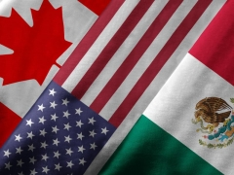
FREE TRADE AGREEMENTS
Reduction or Elimination of Duty
Trading Partner Countries
Certificate of Origin (CoO)

Slide 19
Eric A. Miller
Regional Director-Greater Houston
Export-Import Bank of the U.S.
Eric.miller@exim.gov
281-721-0470

Slide 20

Export Financing:
A Strategic Advantage
Notes:
Title page

Slide 21
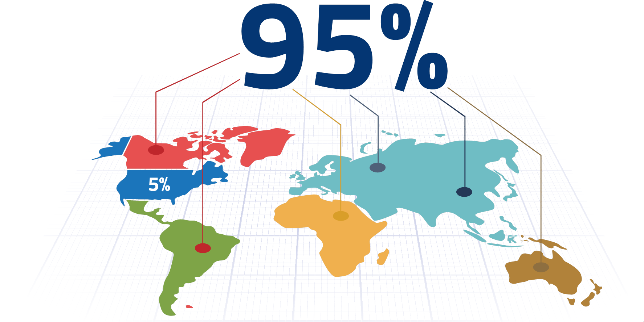
MARKET OPPORTUNITY

Slide 22
WHO WE ARE – WHAT WE DO
EXIM Bank is an independent agency of the U.S. Government
Established in 1934
Headquartered in Washington, D.C.
Regional Offices
EXIM’s Mission: Support American jobs by facilitating the export of U.S. goods and services

Slide 23
3 WAYS EXIM CAN SUPPORT YOU
  Insure your export credit sales
  Provide access to export working capital
  Offer term loans to your foreign buyers

Slide 24
SOLUTION 1: EXPORT CREDIT INSURANCE
Sales Tool
Offer competitive terms to foreign buyers (generally up to 180 days, some products may qualify for 360 day terms)
Risk Protection
Protect against nonpayment by foreign buyers due to commercial risks and political risks
Financing
Enable additional financing. Insured foreign receivables may be added to your borrowing base by assignment of policy proceeds (claim payments) to a lender

Slide 25
HOW EXPORT CREDIT INSURANCE WORKS
Exporter offers
credit term to buyer for services to be performed
Contract states the payment schedule and terms, and buyer accepts
Exporter chooses
insurance policy
Buyer pays. If buyer fails to do so, exporter claims payment with EXIM
Exporter reports
export to EXIM, and pays premium on amount due on services provided
Exporter performs
the services and bills
the buyers

Slide 26
RISKS COVERED
Commercial Risk
Insolvency
Bankruptcy
Protracted Default
Political Risk
Currency Transfer Risk
War, Revolution, Insurrection, Expropriation
Cancellation of an Import or
Export License

Slide 27
AUDIENCE POLL
How long have you been in business?
Less than 1 year
1-5 years
5-10 years
10-20 years
More than 20 years

Slide 28

ELIGIBILITY CRITERIA
Exporters Must:
Be in business at least three years
Have DUNS number and financial statements or tax returns
50+% U.S. content including labor (cost basis)

Slide 29
EXPORT CREDIT INSURANCE POLICIES FOR SMALL BUSINESS*
Express Insurance
95% cover, no deductible, pay-as-you-go, EXIM Bank obtains and reviews all credit info on buyers, maximum of 10 buyers
Small Business Multi-Buyer
95% cover, no deductible, pay-as-you-go, some buyer approval authority may be given to exporter
Single-Buyer
90% cover, no deductible
* Learn More about the SBA Definition of a Small Business -
www.sba.gov/sites/default/files/files/Size_Standards_Table.pdf

Slide 30
EXAMPLE: SMALL BUSINESS EXPRESS INSURANCE RATES
Rates are charged by the length of the credit term you extend and the buyer type:
  Sell to a private sector buyer on terms up to 60 days open account
  Premium cost is $0.65 per $100 of the gross invoice value…
  ……on a $25,000 sale, that’s only $162.50 in premium!

Slide 31
SOLUTION 2: WORKING CAPITAL LOAN GUARANTEE
Provides a 90% guarantee of repayment to a lender (principal and interest) on loans to exporters
No minimum or maximum amounts
Loan supports advances made against export-related inventory (including WIP) and foreign receivables
May also be used to collateralize a stand-by letter of credit or performance bonds

Slide 32
SOLUTION 3: FOREIGN BUYER FINANCE
Alternative financing for creditworthy international buyers
  Capital equipment and related services
  Competitive terms up to 7 years < $10 million
  100 % commercial and political risk coverage on financed amount
  Receive payment in full after shipment
Foreign buyer criteria
  15% down payment required from borrower
  Minimum 3 year trade references history
  Reliable financial statements (Audited if borrowing > $1MM)
  Buyer to meet financial ratios

Slide 33
PERSONAL PRIOR EXPERIENCE: KEY TAKEAWAYS
Existing buyers purchased more
Won more new contracts
Could sleep at night

Slide 34
Q & A Session

Slide 35
AUDIENCE POLL
Would you like to be contacted by EXIM Bank?
Yes, please
No, not at this time
Would you like to be contacted by Preferred Shipping Inc.?
Yes, please
No, not at this time

