Slide 1




Solutions to Support
Export Growth
Presented by:
NAME, Title / Division
Phone # | e-mail@exim.gov

Slide 2
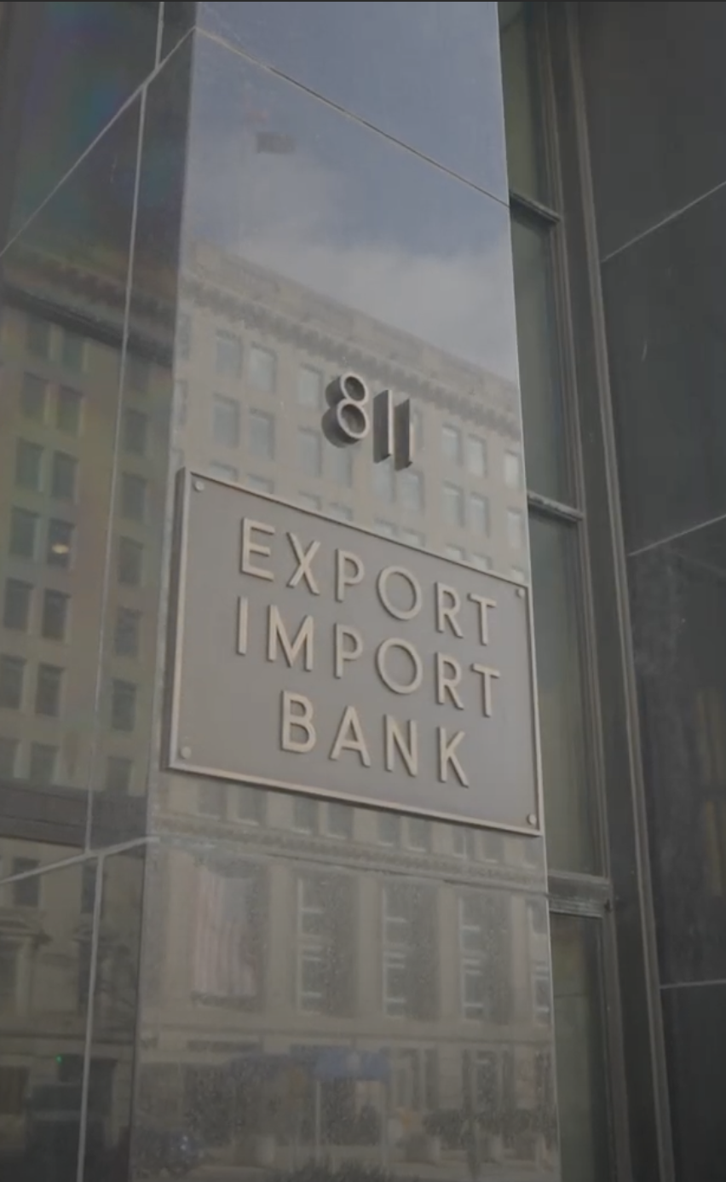



Who We Are
EXIM is a U.S. federal government agency
Established
in 1934
Headquartered in
Washington, D.C.
12 Regional Offices
nationwide
Our Mission: Facilitate U.S. jobs by supporting the growth of U.S. exports. Fill gaps and complement private-sector financing.
Level the playing field for U.S. companies competing for global sales.

Slide 3



WHAT WE DO
Ways EXIM Can Help
1
2
3
Improve competitiveness by insuring your receivables from international sales
Assist in obtaining
pre-export working
capital financing
Support capital equipment exports with term loans
for international buyers
Helping American Businesses
Win the Future

Slide 4


Why Do Only 1% of Companies Export?
Fear of the unknown…RISK!

Slide 5

SALES TERMS AS A
Spectrum of Risk
Cash in
Advance
Letters of Credit (L/C)
Cash Against
Documents
Open
Account
SELLER RISK
Low Risk
High Risk
BUYER RISK
High Risk
Low Risk

Slide 6

EQS is an insurance policy for underserved businesses, which includes minority, women, veteran, rural, and disability-owned companies.
The policy covers the account receivable created by selling to an international buyer on open account credit terms.
With a policy in place, your company can offer open account credit terms (60 days, 120 days, etc.) to win new customers and increase sales to existing buyers, while reducing the risk of nonpayment.
Equity Express
Select (EQS)
An Equity Express Select policy covers receivables generated by international sales.

Slide 7

EQS Benefit Details
Equity Express Select’s (EQS) exceptional
in-house customer service team is ready to expertly assist you from policy explanation to application, addressing any of your concerns along the way.
95% coverage
No deductible
No application or policy issuance fees
Dedicated in-house servicing teams
Pay-as-you-ship premiums

Slide 8
Show certification/verification of MWOB status (Minority, Women, Veteran, Rural, or Disability-Owned)*
Be a small business, as defined by the Small Business Administration (SBA)
Obtain and maintain an active SAM.gov registration, including the issuance of a Unique Entity Identifier (UEI)
Have a DUNS number from Dun & Bradstreet
Have not previously utilized other EXIM insurance policies
* Rural qualification based on exporter zip code
EQS Policy
Qualifications
To obtain an EQS Policy, a business must fulfill the following requirements.

Slide 9
Here is an example of your premium rates per $100 of your invoice, for a private-sector buyer
EQS Policy
Rates
Payment Term | Private-Sector Premium Rate*
1 – 60 days | $0.55
61– 120 days | $0.90
121 – 180 days | $1.15
TIP: You can get a 25% discount on the rates shown if your business also has a Working Capital Loan from EXIM or the U.S. Small Business Administration (SBA).
Pricing Example:
You have an order for $25,000 to a distributor in Mexico. The buyer’s company is a private-sector business and has agreed to 30-day credit terms.
The cost to insure this $25,000 order would be $137.50. Most businesses incorporate the cost of this premium into their sales price.
* Private-sector buyer rates are shown. Different rates apply for sovereign buyers that you may be selling to

Slide 10

How Does EQS Work?
Your company identifies an international buyer and applies for export insurance.
EXIM provides credit decisions on your buyer.
Your company offers credit terms to the approved buyer.
Your international buyer accepts the terms of the deal.
Your company ships your product and invoices your buyer.
Your company reports shipments and pays a premium on the amount shipped.
The buyer pays. If they fail to do so, EXIM pays.

Slide 11
EXIM Policy Coverage
Benefits by Product
Benefits By Product | Express MB | ENB MB | EQS MB
Coverage % | 95 | 95 | 95
DCL | None | Yes | None
Deductible | None | None | None
Premium Rate | 1-60 Days: 0.0065 61-120 Days: 0.0106 121-180 Days: 0.0135 | 1-60 Days: 0.0055 61-120 Days: 0.009 121-180 Days: 0.0115 | 1-60 Days: 0.0055 61-120 Days: 0.009 121-180 Days: 0.0115
Report Shipments | Monthly | Monthly | Monthly
Period Covered | 12 Months | 12 Months | 12 Months
Claim Filing | 3-8 Months | 3-8 Months | 3-8 Months
Policy Issuance Fee | $500 | $500 | None
Dedicated Underwriter | No | No | Yes
Graduation Period | 3 Years | None | 5 Years
Maximum Aggregate | None | None | $500,000

Slide 12

WHAT IS NEXT?
Get Started
With EQS, You Have a Dedicated
In-house Team
Equity Express Select’s exceptional in-house customer service team is ready to guide you through every step of the process, from explaining policy benefits and reviewing qualifications to streamlining the application and addressing any concerns you may have along the way
Request a Free Consultation

Slide 13

Export Credit Insurance
Benefits:
Risk Protection
Protects against buyer nonpayment due to
commercial and political risks
Sales Tool
Allows exporter to offer competitive credit terms
to foreign buyers, generally up to 180 days,
some products may qualify for 360-day terms
Financing Aid
Obtain additional financing – insured foreign receivables
may be added to your borrowing base by assignment
of policy proceeds (claim payments) to a lender

Slide 14

SHORT-TERM
Export Credit Insurance
Multi-Buyer
(entire export portfolio)
95% coverage, no deductible (for “small business” policies only), pay-as-you-go, some buyer approval authority may be given to exporter
Multi-Buyer
Select Risk
(a negotiated portfolio)
95% coverage, first-loss deductible, pay-as-you-go, some buyer approval authority may be given
to exporter
Single-Buyer
(single or multiple
shipments to one buyer)
90% coverage, no deductible

Slide 15




How Export Credit Insurance Works
Step 1:
You identify an international buyer and obtain an Export Credit Insurance policy.
Step 5:
You report shipments and pay premiums on the amount shipped.
Step 3:
The buyer accepts
the deal’s terms.
Step 2:
Step 4:
You ship your product and invoice the buyer.
Step 6:
The buyer pays. If they fail to do so, EXIM pays.
You offer credit terms to your foreign buyer.

Slide 16


What is Covered?
Commercial Risks:
Political Risks:
Insolvency
Bankruptcy
Protracted Default
War, revolution, insurrection
Currency transfer risk
Cancellation of import
or export license
Disputes with the buyer are not covered

Slide 17

Provides a 90% guarantee of repayment
(principal and interest) on loans to exporters
May be set up as a “Transaction-specific”
or a “Revolving” line of credit
No minimum or maximum amounts
Loan supports advances made against export-related
and potentially export-related inventory
(including WIP) and foreign receivables:
  Up to 75% advance rate on inventory, and up to 90% on foreign receivables
Working Capital
Loan Guarantee
Empowers exporters to unlock
cash flow to fulfill sales orders
and take on new business abroad

Slide 18

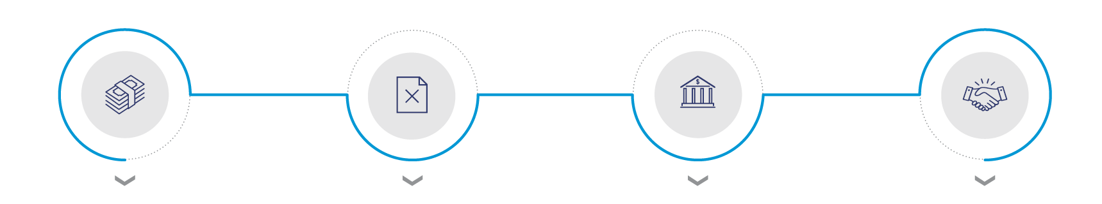
How The Working Capital
Loan Guarantee Works
Step 1:
Step 2:
Step 3:
Step 4:
You export and want to
grow export sales,
but need to finance export accounts receivable
and inventory destined
for export.
You apply for a working
capital loan, but your lender won’t approve it because your collateral
is export-related.
Lenders with delegated
authority process your working capital loan under established EXIM criteria.
Your lender loans you the money. You use the funds to fulfill your export sale.

Slide 19
85% financed, 15% cash down payment by the buyer (may be financed by lender)
Repayment up to 5 years, exceptionally 7 years
Amounts of $25 million or less
Long-term financing for projects
Medium-Term
Financing
Generally used for foreign buyer financing of capital equipment

Slide 20



China & Transformational Exports Program
Purpose: Support the extensions of loans, guarantees, and insurance at rates and on terms that are fully competitive, to the extent practicable, with those provided by China,
in order to:
Directly neutralize competing subsidies provided by China through official export credit, tied aid or blended finance, or
Advance the comparative leadership of the US with respect to China in strategic industries

Slide 21










Transformational Areas
Artificial Intelligence
Biomedical Science
Quantum Computing
Biotechnology
Wireless Communications Equipment
Renewable Energy, Storage, & Energy Efficiency
Fintech
High Performance Computing
Semiconductors
Water Treatment & Sanitation

Slide 22


Coverage Details:
No U.S. content requirement. Instead, 25% export nexus
More flexible structure (e.g., repayment terms)
Every 5.3 jobs are eligible for up to $1 million in support
The Make More
in America Initiative
Example of Eligible Projects:
U.S. company exports 25% of U.S. production
  Export nexus of 15% for small business, transformational export areas and climate related transactions
Company sells 50% of production to a company who exports 30% of their productions
Contact: Domestic.Finance@exim.gov
New as of April 2022:
EXIM can now offer its financing for domestic projects, with a focus on reshoring supply chains

Slide 23
Building new manufacturing facilities
Expanding or renovating existing manufacturing facilities
Purchasing new capital for equipment or manufacturing facilities
Acquiring land (under certain circumstances)
Financing other investments in long-term international competitiveness of the U.S. industrial base
The Make More
in America Initiative Projects Can Include

Slide 24


A Few Restrictions
No military or defense-related products or obligors (exceptions apply)
Must ship from a U.S. port
Open in over 180 countries

Slide 25
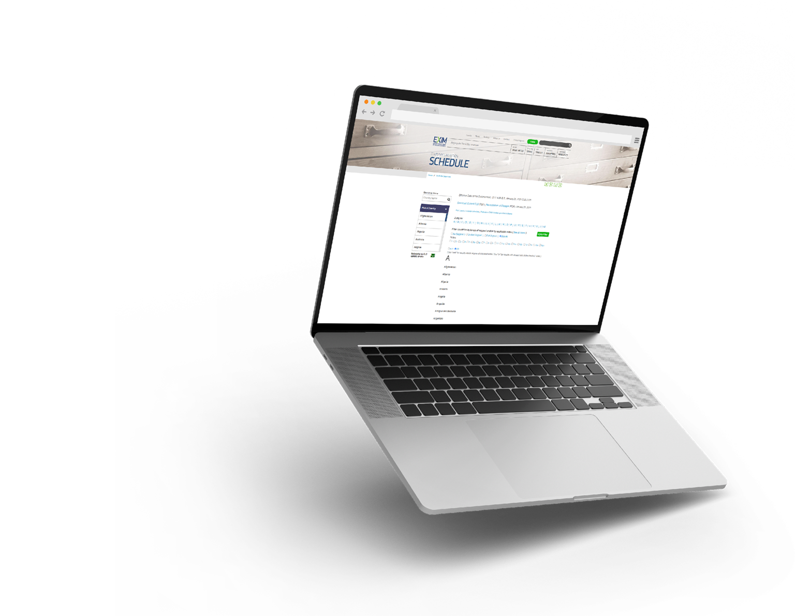

Tools for Exporters
Country Limitation Schedule
EXIM conducts business in most countries throughout the world
Restrictions may apply based on political or economic conditions and are highlighted on the Country Limitation Schedule
Open in over 180 countries
Check the Country Limitation Schedule (CLS) at www.exim.gov

Slide 26


NAME
Title, Division
E-mail@exim.gov
Phone #
EXIM’s presentations are intended to highlight various facets
of exporting, but are not legal advice, and are not intended to summarize all legal requirements associated with exporting.

