Slide 1

EXIM BANK
Solutions to Support
Your Export Growth
Insights from the Minority & Women-Owned Business Outreach Division (MWOB)
Prepared for: Business Name Here

Slide 2

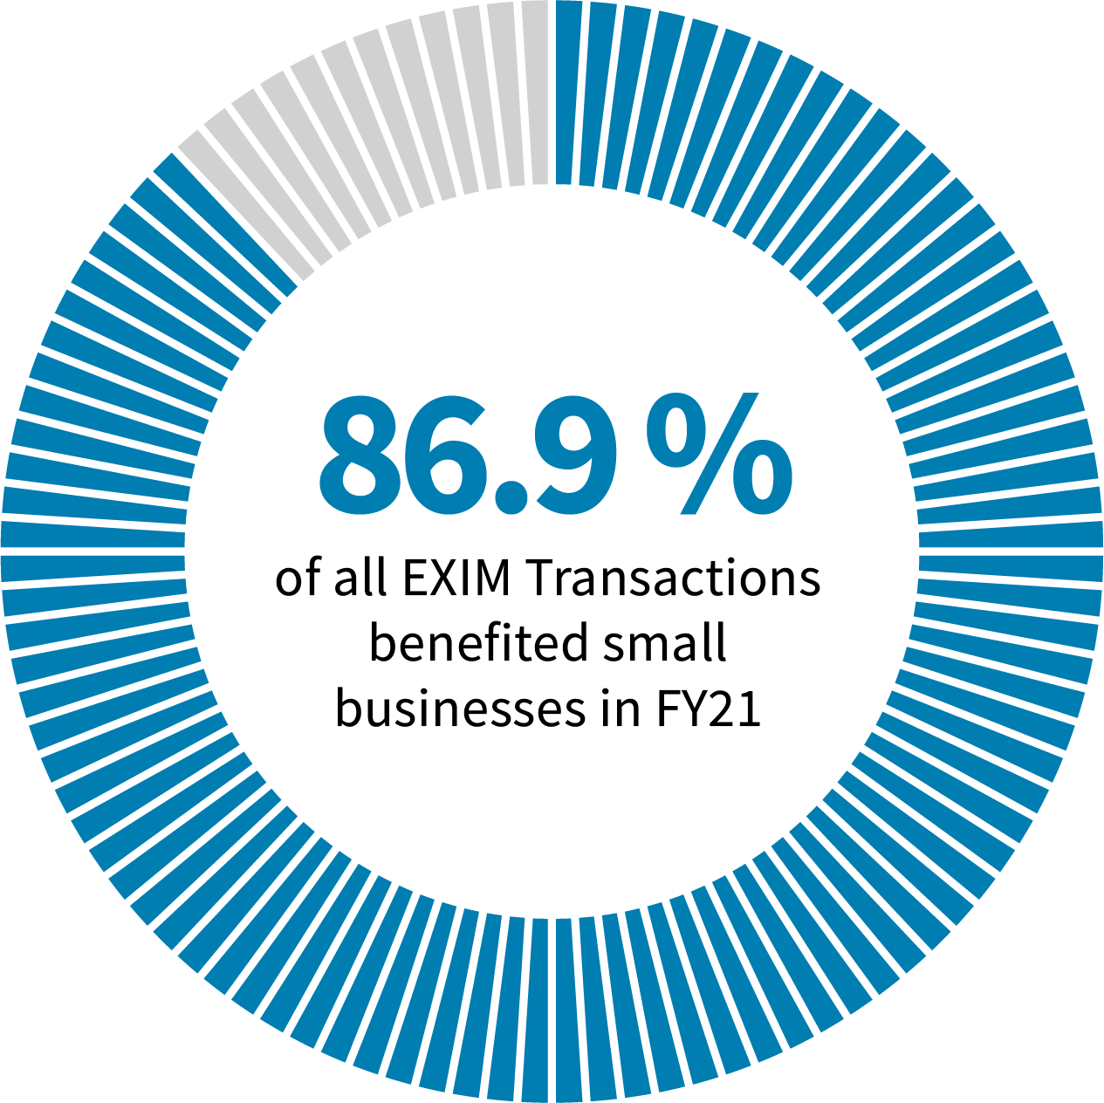

What is EXIM?
EXIM is the official Export Credit Agency (ECA) of the United States.
Mission: Maintain & create U.S. jobs by supporting the growth of U.S. exports.
Fills gaps or complements private-sector financing.
Levels the playing field for U.S. companies competing for global sales.
MWOB Division

Slide 3

At EXIM, Equity, Diversity & Inclusion are major priorities; we proudly provide support to all members of the underserved business community.
MWOB Division

Slide 4

Meet the MWOB Team
Our Minority- and Woman-Owned Business, or MWOB, Outreach Division seeks to expand inclusiveness through:
Ensuring an equitable distribution of services
Training exporters on the availability of EXIM support
Increasing community awareness of other resources
Offering educational activities including seminars, trade shows, webinars, roundtables, and more
Nurturing clients to meet eligibility requirements for government assistance programs and financing
MWOB Division

Slide 5

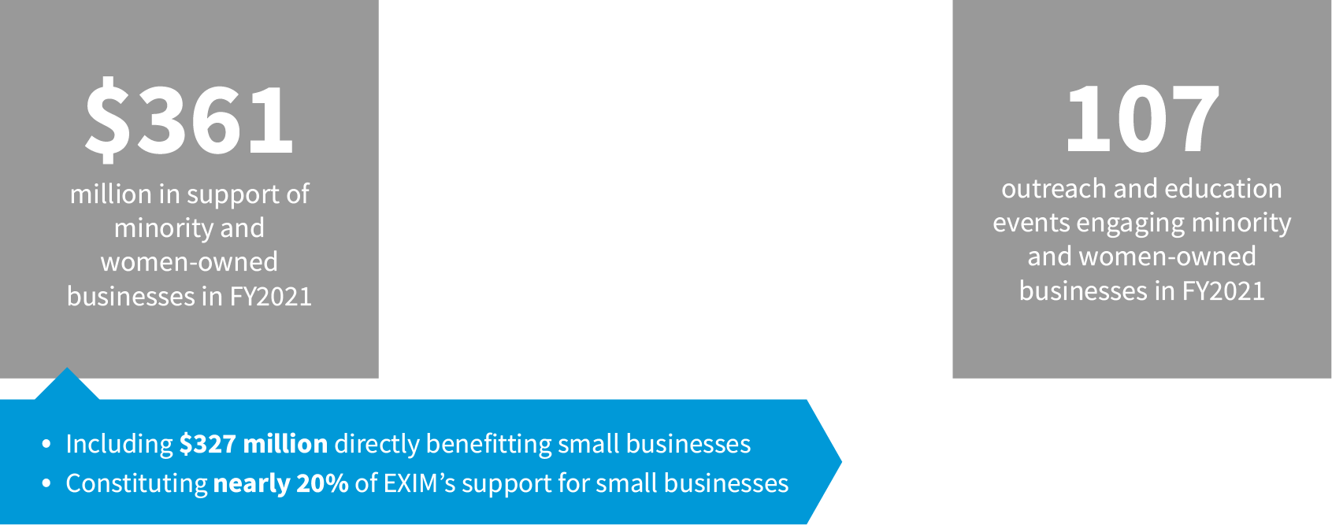
Minority & Women-Owned Business Outreach
MWOB Division

Slide 6
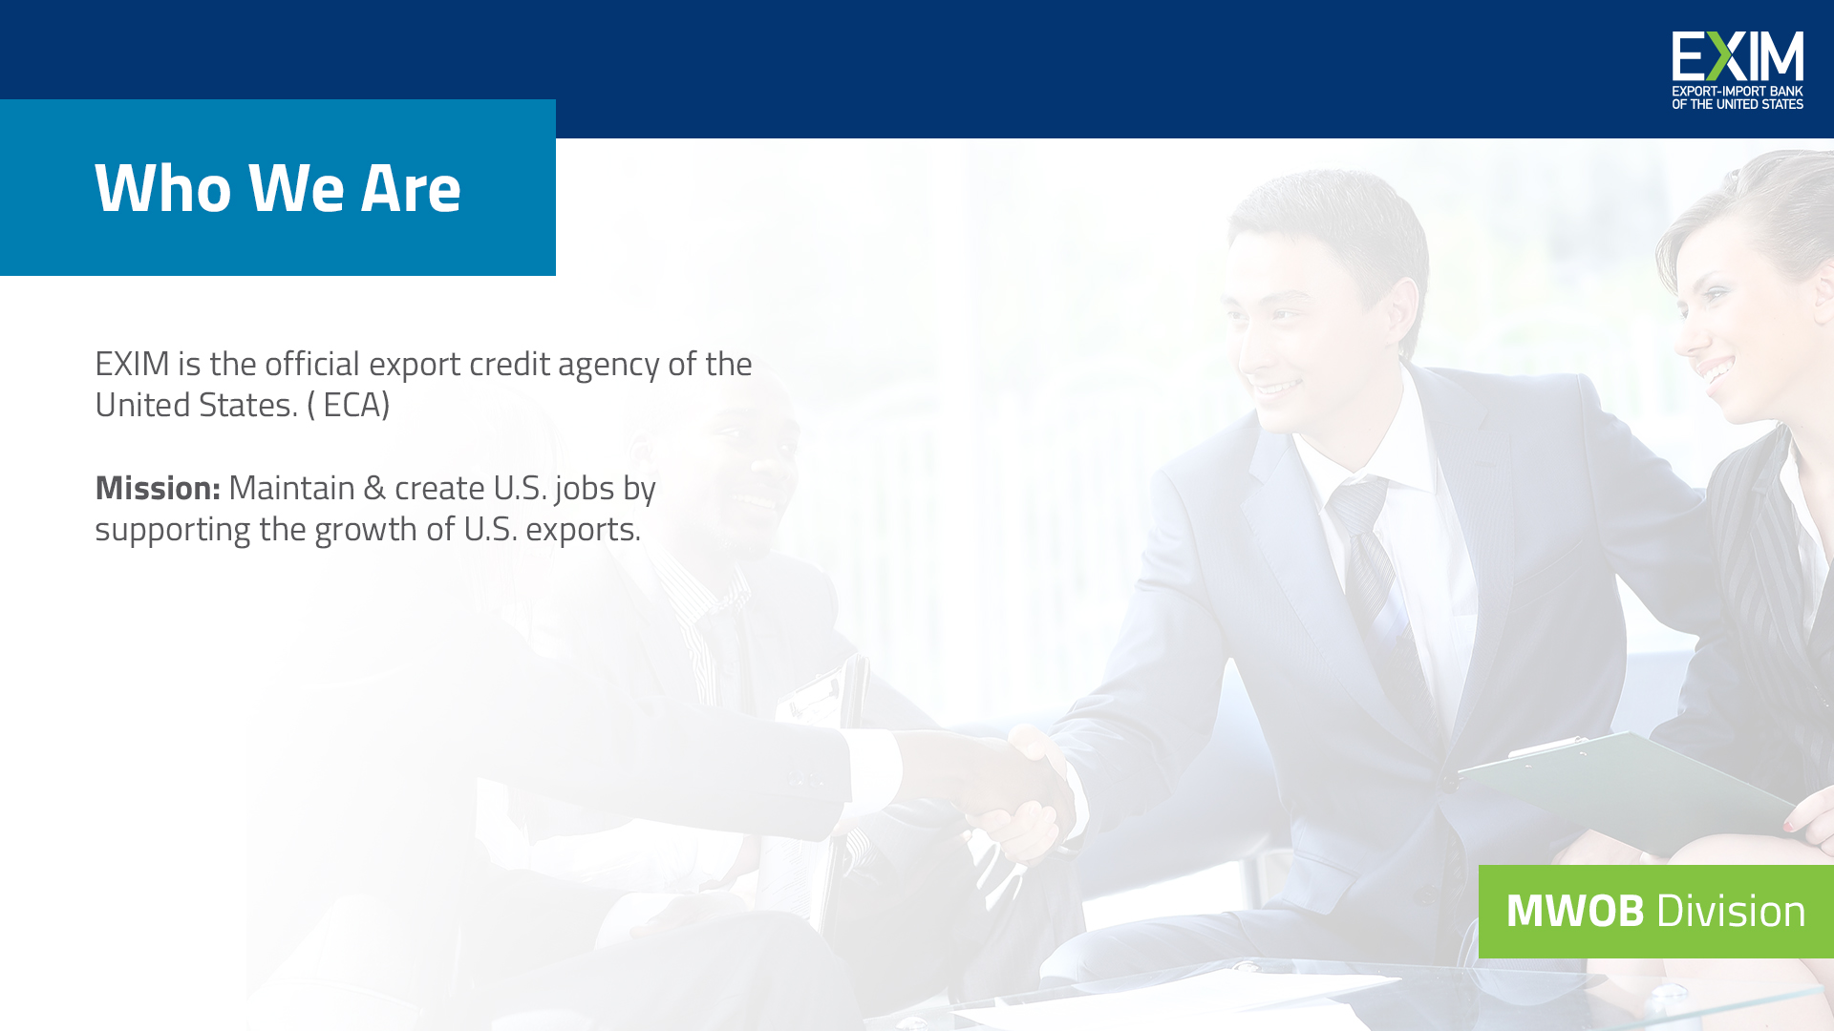

Why Should You Export?
Access to more consumers and businesses
Diversifying market opportunities
Minority-owned businesses are uniquely qualified and connected to overseas markets
MWOB Division

Slide 7

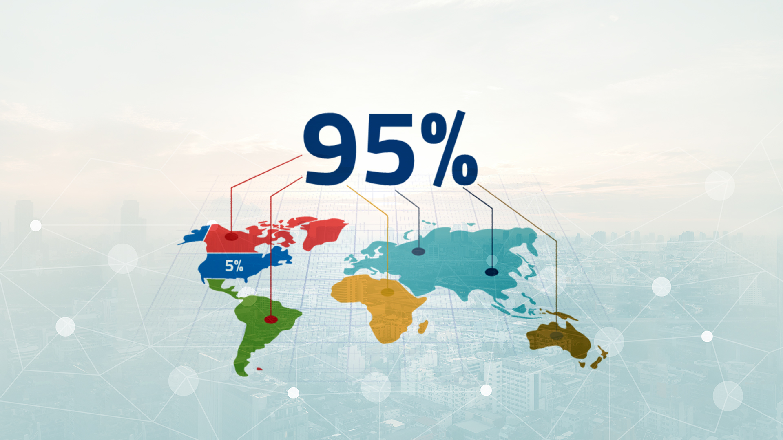
Global Business
of consumers are outside of the U.S.
MWOB seeks to engage minority- and women-owned businesses that are interested in exporting their goods and services, educate them regarding the availability of EXIM financing, and increase the total amount of financing to support exports from these businesses.
In FY 2020, EXIM staff participated in 86 outreach and education events across the country engaging minority- and women-owned businesses. In FY 2020, EXIM approved $335.4 million in support of MWOB businesses.
Minority-owned and women-owned businesses accounted for 14.6% of Small business Authorizations
MWOB Division

Slide 8

Why Do Only 1% of Companies Export?
Fear of the unknown…RISK!
MWOB Division

Slide 9





OUR FINANCING
Makes the Difference
MWOB seeks to engage minority- and women-owned businesses that are interested in exporting their goods and services, educate them regarding the availability of EXIM financing, and increase the total amount of financing to support exports from these businesses.
In FY 2020, EXIM staff participated in 86 outreach and education events across the country engaging minority- and women-owned businesses. In FY 2020, EXIM approved $335.4 million in support of MWOB businesses.
Minority-owned and women-owned businesses accounted for 14.6% of Small business Authorizations
Level the playing field
Minimize risk
Supplement commercial financing
MWOB Division

Slide 10

Make More in America Initiative
New! As of April 14, EXIM can now offer its financing for domestic projects
Focus On Reshoring Supply Chains
Benefits
  No 51% or 85% U.S. content requirement → Instead 15% export nexus
  More flexibility in structure (e.g., repayment terms)
  Every 5.3 jobs → eligible for up to $1 million in support
Examples of Eligible Projects
  U.S. company exports 15% of U.S. production
  Company sells 50% of production to a company who exports 30% of their production
Contact: Domestic.Finance@exim.gov
MWOB Division

Slide 11

Working Capital Loan Guarantee
BENEFITS
Pay for materials, equipment, supplies, labor, and other inputs to fulfill export orders.
Provides 90% guarantee of repayment to
the lender
More attractive advance rates than conventional financing.
MWOB Division

Slide 13

Export Credit Insurance
BENEFITS
Risk Protection
Protects against buyer nonpayment due to commercial risks and political risks.
Sales Tool
Allows exporter to offer competitive credit terms to foreign buyers, generally up to 180 days, some products may qualify for 360-day terms.
Financing Aid
Obtain additional financing. Insured foreign receivables may be added to your borrowing base by assignment of policy proceeds (claim payments) to a lender.
MWOB Division

Slide 14




HOW DOES EXPORT
CREDIT INSURANCE WORK?
Step 1:
Step 5:
You report shipments and pay premiums on the amount shipped.
You identify an international buyer and obtain an Export Credit Insurance policy.
Step 3:
The buyer accepts the deal’s terms.
Step 2:
Step 4:
You ship your product and invoice the buyer.
Step 6:
The buyer pays. If they fail to do so, EXIM pays.
You offer credit terms to your foreign buyer.

Slide 15


WE SUPPORT
A Variety of Industries
Manufacturing
Construction Equipment
Medical Equipment
Mining
Power-generation
Aircraft & Avionics
Services
Renewable Energy
Agribusiness
Wholesale/Retail
Oil & Gas

Slide 16



CASE STUDY
AcousticSheep®
CHALLENGE
Dr. Wei-Shin Lai, a family physician, designed headphones that play music, audiobooks, and other sounds helpful for a restful night.
Twelve years later, the couple is successfully making their invention work for others around the world.
Erie, PA
Woman-owned
small business
With EXIM’s Support, Acoustic Sheep:
Continued exports in its original markets and expanded into two new countries
Grew its international sales at about 15 percent per year
Exports now comprise a quarter of the company’s total revenue
Exports to Europe, Asia, Australia
Uses Export Credit Insurance
Working with EXIM since 2017
MWOB Division

Slide 17

CASE STUDY
AcousticSheep®
CHALLENGE
Dr. Wei-Shin Lai, a family physician, designed headphones that play music, audiobooks, and other sounds helpful for a restful night.
Twelve years later, the couple is successfully making their invention work for others around the world.
Erie, PA
Woman-owned
small business
With EXIM’s Support, Acoustic Sheep:
Continued exports in its original markets and expanded into two new countries
Grew its international sales at about 15 percent per year
Exports now comprise a quarter of the company’s total revenue
Exports to Europe, Asia, Australia
Uses Working Capital Loan Guarantee
Working with EXIM since 2017
MWOB Division

Slide 18
CASE STUDY
AcousticSheep®
CHALLENGE
Dr. Wei-Shin Lai, a family physician, designed headphones that play music, audiobooks, and other sounds helpful for a restful night.
Twelve years later, the couple is successfully making their invention work for others around the world.
Erie, PA
Woman-owned
small business
With EXIM’s Support, Acoustic Sheep:
Continued exports in its original markets and expanded into two new countries
Grew its international sales at about 15 percent per year
Exports now comprise a quarter of the company’s total revenue
Exports to Europe, Asia, Australia
Uses ECI and WCLG
Working with EXIM since 2017
MWOB Division

Slide 19
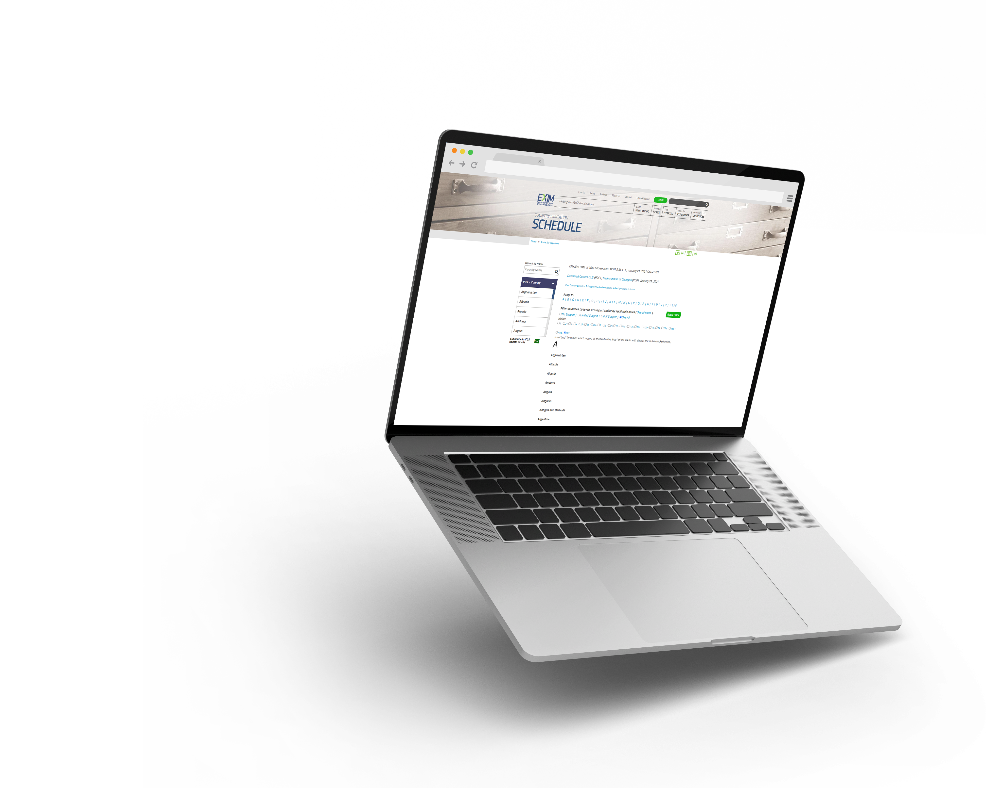
TOOLS FOR EXPORTERS
Country Limitation Schedule
EXIM Bank conducts business in most countries throughout the world.
Restrictions may apply based on political or economic conditions and are highlighted on the Country Limitation Schedule.
Open in over 180 countries
MWOB Division

Slide 20


A Few Restrictions
No military or defense-related products or obligors (exceptions apply)
Must ship from a U.S. port
U.S. content policy
MWOB Division

Slide 21

ARE YOU
Ready to Export?
Get counseling and training
Find buyers for products or services
Get funding
MWOB Division

Slide 22

Additional
Resources & Assistance
Insurance Brokers: Broker Locator
www.exim.gov/resources/insurance-broker-locator
Regional Export Promotion Program (REPP) Members: REPP Locator
www.exim.gov/resources/repp-locator
Delegated Lenders: Working Capital
www.exim.gov/resources/delegated-authority-lenders
MWOB Division

Slide 23





Stay Connected to EXIM
LinkedIn: https://www.linkedin.com/company/eximbankus
Twitter: https://twitter.com/eximbankus
EXIM Blog: https://grow.exim.gov/blog
Facebook: https://www.facebook.com/eximbankus
Instagram: https://www.instagram.com/eximbankus
MWOB Division

Slide 24


Questions?
MWOB Division

Slide 25

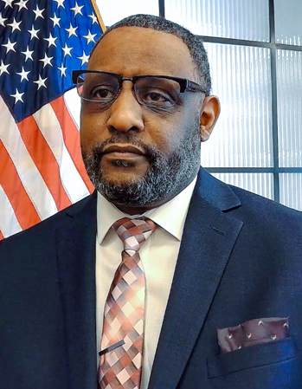
Aerek Stephens
(205) 375-8909
aerek.stephens@exim.gov
Schedule a Consultation
https://grow.exim.gov/aerek-stephens
MWOB Division

Slide 26
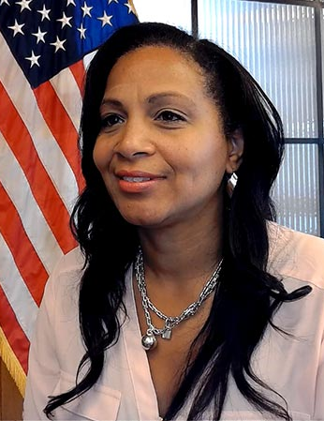
Tamara Maxwell
(202) 565-3375
tamara.maxwell@exim.gov
Schedule a Consultation
https://grow.exim.gov/tamara-maxwell
MWOB Division

Slide 27
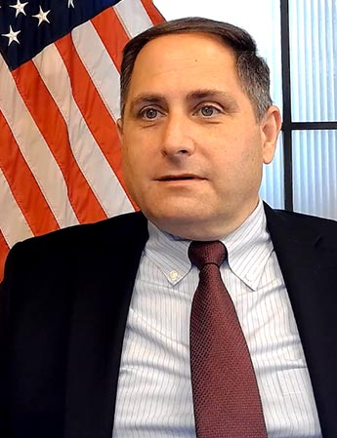
Jonathan Brady
(202) 640-0161
jonathan.brady@exim.gov
Schedule a Consultation
https://grow.exim.gov/jonathan-brady
MWOB Division

Slide 28
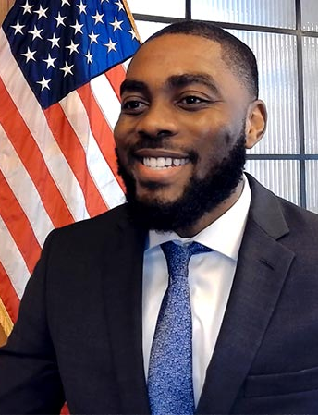
Edens Duphresne
(202) 725-4243
edens.duphresne@exim.gov
Schedule a Consultation
https://grow.exim.gov/edens-duphresne
MWOB Division

Slide 29
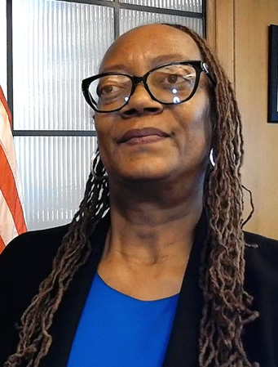
LaTaunya Darden
(202) 320-1126
lataunya.darden@exim.gov
Schedule a Consultation
https://grow.exim.gov/lataunya-darden
MWOB Division

Slide 30
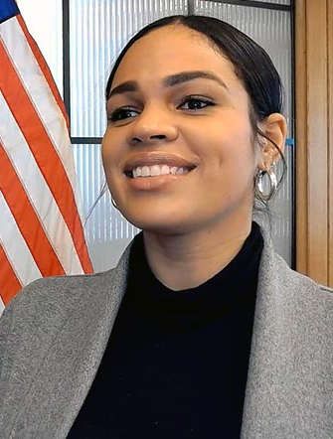
Nicole Woods
(202) 565-3296
nicole.woods@exim.gov
Schedule a Consultation
https://grow.exim.gov/nicole-woods
MWOB Division

Slide 31
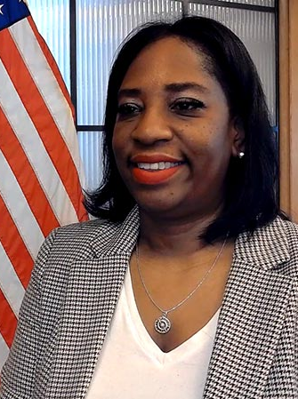
Toya Woods
(202) 258-8561
toya.woods@exim.gov
Schedule a Consultation
https://grow.exim.gov/toya-woods
MWOB Division

