Slide 1



EXIM
Preparing for an International Trade Mission to Set Up for Success!
Jennifer Krause, Managing Director for Broker Accounts

Slide 2

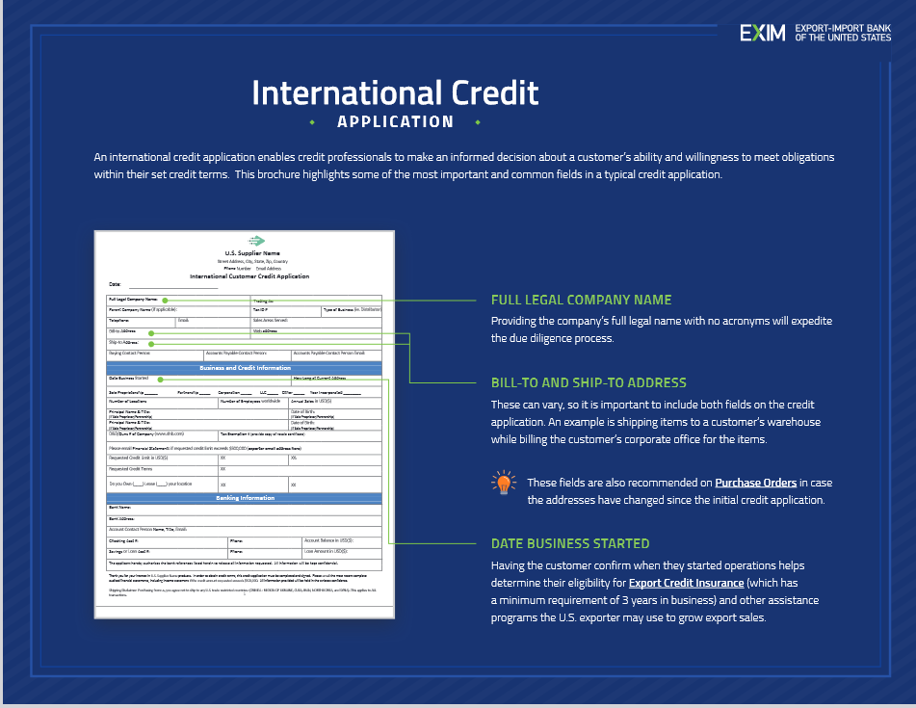
Customer Credit Application
A credit application enables a company to make an informed decision about an international customer’s ability and willingness to meet obligations within their set credit terms.
This brochure highlights some of the most important and common fields in a typical credit application
https://grow.exim.gov/hubfs/resources/EXIM-intl-credit-app.pdf

Slide 3
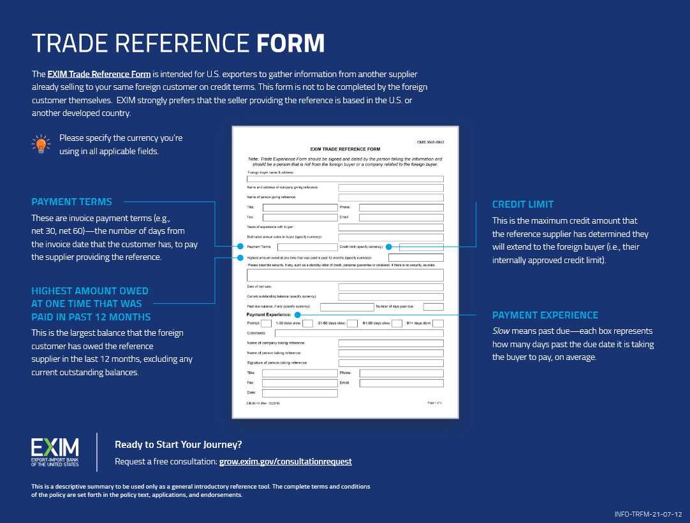
Supplier Trade Reference Form
A Supplier Trade Reference Form is intended for U.S. exporters to gather information from another supplier already selling to your same international customer on credit terms. This form is not to be completed by the international customer themselves.
We also recommend that the seller providing the reference is based in the U.S. or another developed country.
https://grow.exim.gov/hubfs/resources/EXIM-trade-reference-form.pdf

Slide 4
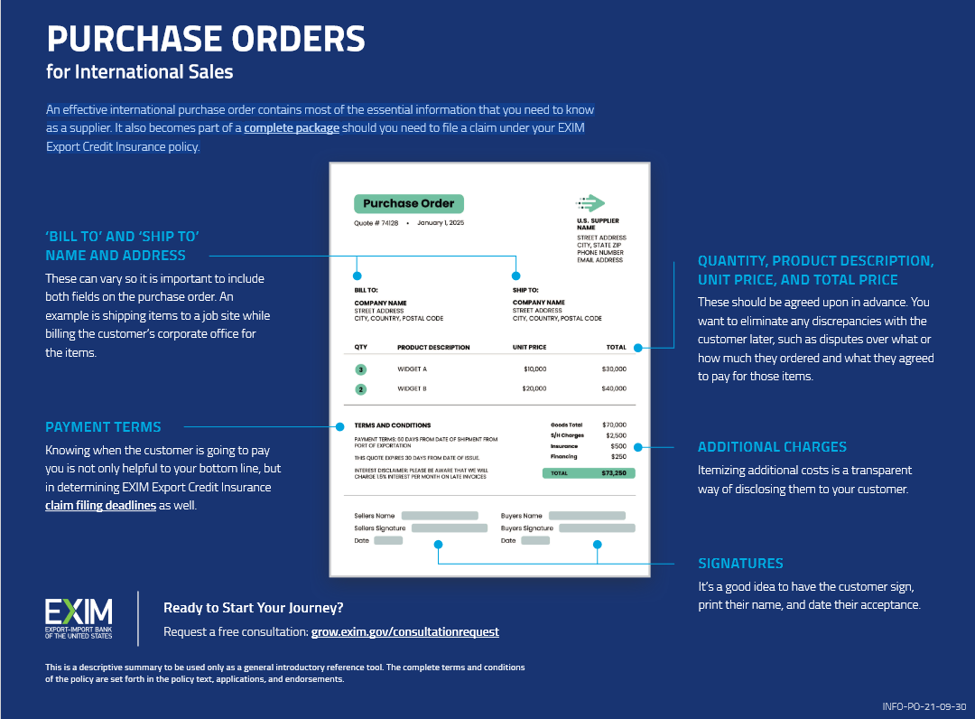

Customer
Purchase Orders
An effective international purchase order contains most of the essential transaction information that you need to know as a supplier.
It also becomes part of a complete package should you need to file a claim under your EXIM Export Credit Insurance policy.
  https://grow.exim.gov/hubfs/resources/EXIM-purchase-orders.pdf

Slide 5




How Export Credit Insurance Works
Step 1:
You identify an international buyer and obtain an Export Credit Insurance policy.
Step 5:
You report shipments and pay premiums on the amount shipped.
Step 3:
The buyer accepts
the deal’s terms.
Step 2:
Step 4:
You ship your product and invoice the buyer.
Step 6:
The buyer pays. If they fail to do so, EXIM pays.
You offer credit terms to your foreign buyer.

Slide 6


What is Covered?
Commercial Risks:
Political Risks:
Insolvency
Bankruptcy
Protracted Default
War, revolution, insurrection
Currency transfer risk
Cancellation of import
or export license
Disputes with the buyer are not covered

Slide 7

Coverage Details:
95% coverage. Insuring all accounts is optional
No discretionary credit limit, EXIM reviews and makes credit decisions on all buyers
No deductible, no application fee
Policy Issuance Fee: $500 (refundable)
Small Business
Express
Insurance
Rates per $100*:
Same rates for any country risk. Based on the length
of the credit term offered to buyers.
1-60 days: $0.65
61-120 days: $1.06
121-180 days: $1.35
For small businesses new to exporting with:
≤$10 million export credit sales
10 or fewer buyers
no more than five years of export credit experience
*For private sector buyers

Slide 8
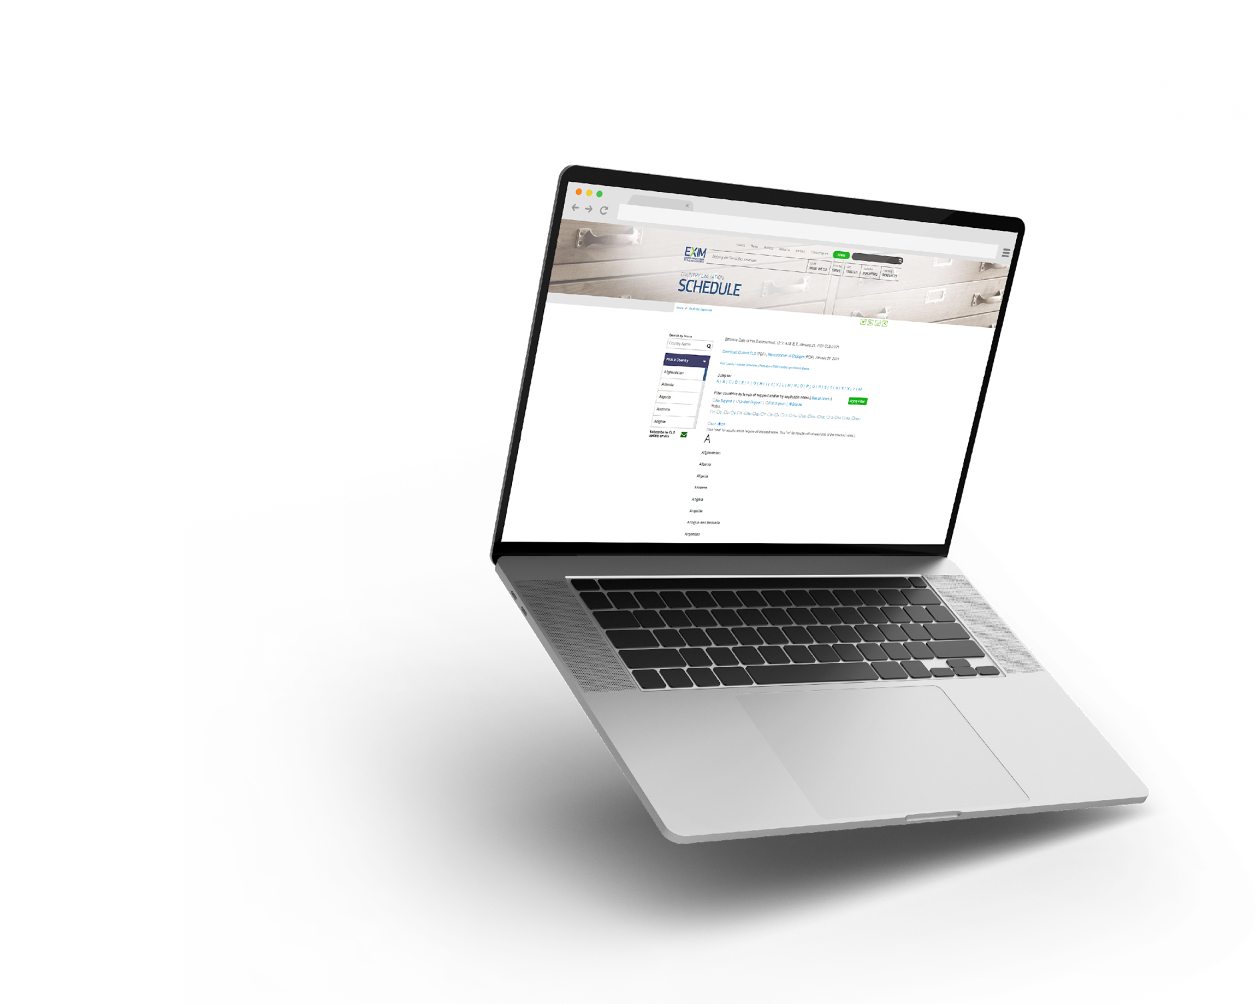
TOOLS FOR EXPORTERS
Country Limitation
Schedule
EXIM conducts business in most countries throughout the world
Restrictions may apply based on political or economic conditions and are highlighted on the Country Limitation Schedule
  Check the Country
  Limitation Schedule (CLS)
  at www.exim.gov.
Open in over 185 countries

Slide 9


Eligibility Criteria
Your products are shipped from U.S. with more than 50% U.S. content including labor & overhead, but not mark-up
You have been in business for more than 1 year and can produce full year revenue financials or tax returns
Have a DUNS number with Dun & Bradstreet
Obtain and maintain an active SAM.gov registration, including the issuance of a Unique Entity Identifier (UEI)

