Slide 1





Tools for U.S. Exporters
For sound, ensure speakers are on and the system has not been muted
Please be sure to disable any pop-up blocking software
If you experience technical problems,
click the “Help” button below

Slide 2

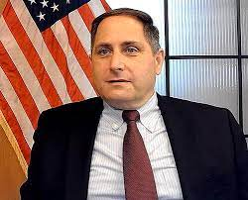
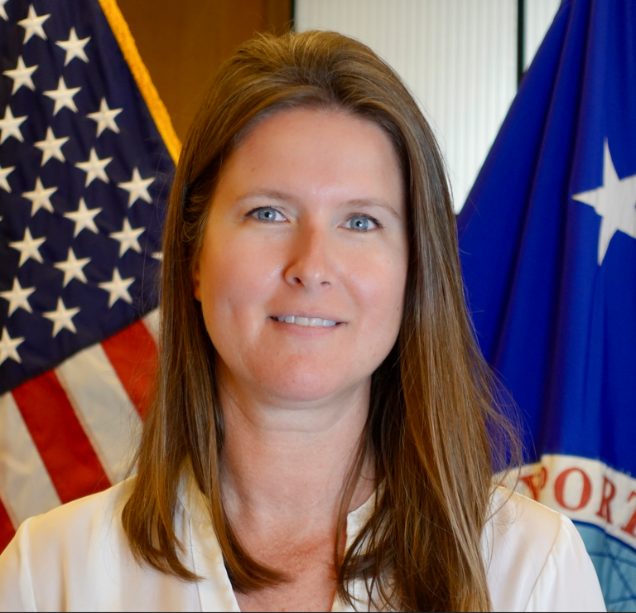
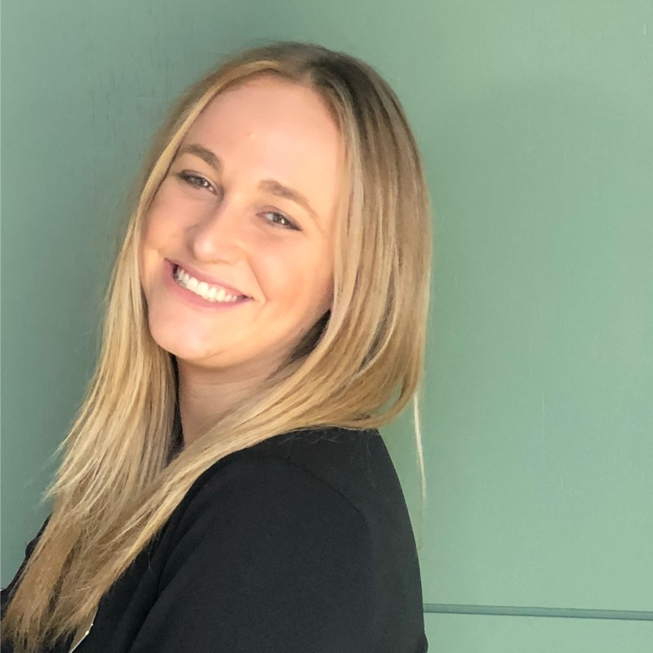
Jonathan Brady
Business Development Specialist
EXIM
Justine Shank Business Development Specialist
EXIM
Jennifer Krause Managing Director for Broker Accounts
EXIM

Slide 3

AGENDA
Jonathan Brady
MWOB Outreach Group
EXIM
Introduction of EXIM MWOB Division
EXIM Country Limitation Schedule
U.S. Commercial Service GDEI
Jennifer Krause
Channel Operations
EXIM
Intl Company Profile (ICP) Reports
Country Commercial Guides
International Partner Search
Gold Key Service (GKS)
STEP Grant can cover these USCS costs
Justine Shank
Outreach & Education
EXIM
EXIM Blog!

Slide 4


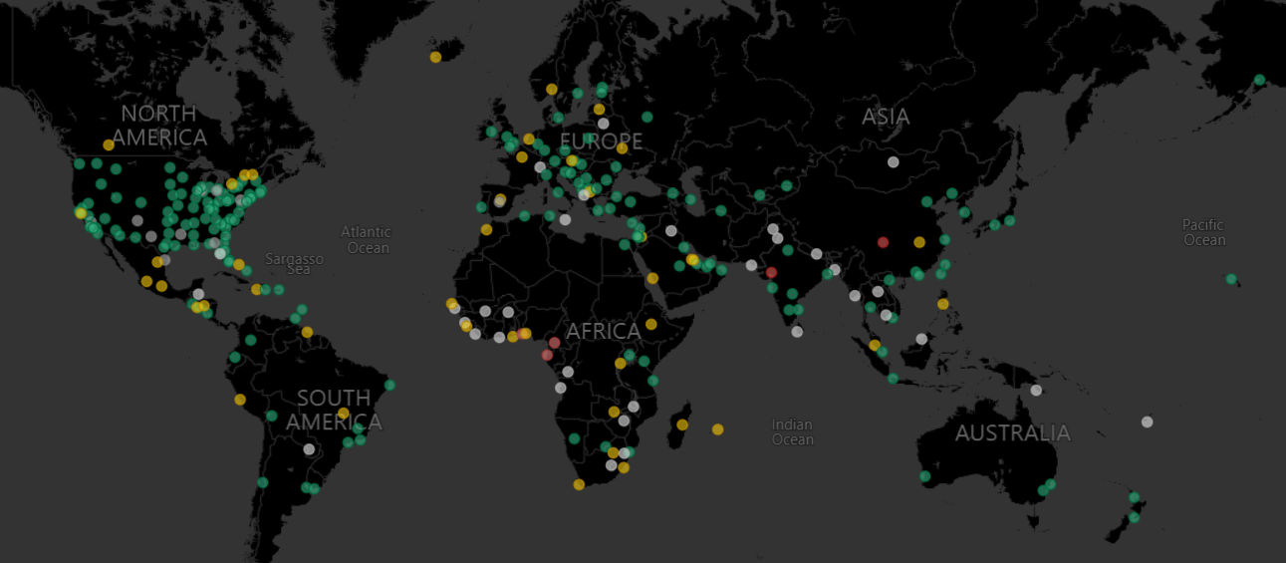
An EXIM sister-agency, with a presence in over 80 countries (including 100 offices in the U.S.A.)

Slide 5
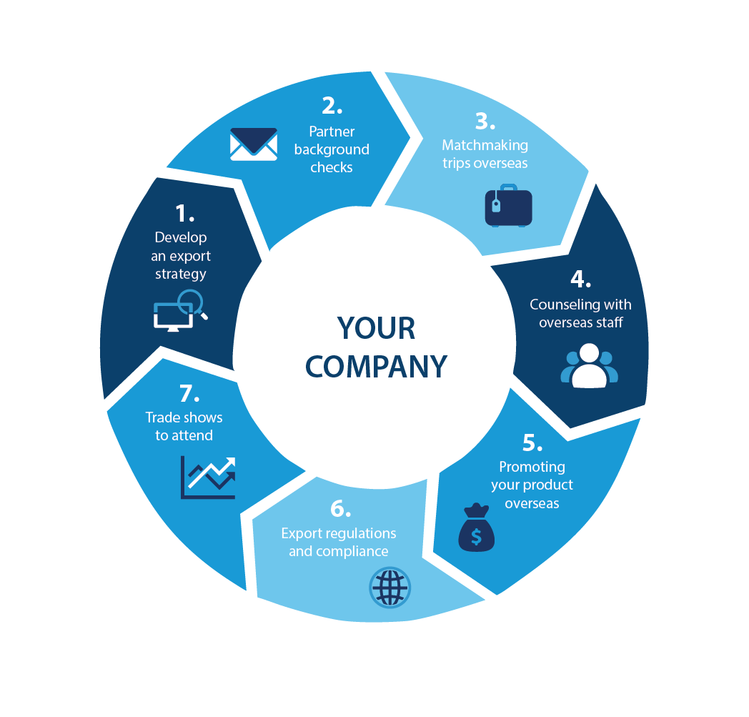

Supporting your export growth every step of the way.
Supporting your export growth every
step of the way.
U.S. Department of Commerce | U.S. Commercial Service
Notes:
Our local trade specialists across the country engage with companies to help them develop an export strategy. This can include helping companies to operationalize for exporting, optimize their exporting procedures including compliance with export regulations, helping them find target markets through in-depth market research.
We engage companies with our overseas offices to provide counseling on local market dynamics and market entry strategies.
We customize matchmaking programs to help you speed your time to market by helping you find a co-development partner, customers, and/or end-users overseas.
Once you’ve found a prospective partner, we can conduct a background check, called an International Company Profile, on that partner that evaluates their capabilities, legitimacy and financial strength.
The U.S. Commercial Service is attends the major industry sector trade shows. In many cases, we bring international buyer delegations to the show to meet with U.S. companies.

Slide 6


Market Intelligence
International Company Profile
The ICP provides U.S. companies with a comprehensive background report and full analysis on a speciﬁc foreign company. Reports provide general business information, background and product information, key ofﬁcials, references contacted by ITA, ﬁnancial data/credit worthiness, reputation, results of site visits and interviews with principals; information sources consulted in preparing the report.
The fee for an International Company Profile “Full” can range from $700 to 2,000 depending on company size ($700 for small companies, $1,200 for medium companies, and $2,000 for large companies)
Country Commercial Guides
Prepared by trade and industry experts, Country Commercial Guides provide information on market conditions, opportunities, regulations and business customs for over 125 countries. Country Commercial Guides detail important factors to help you decide if a market is right for your product or service.
There is no fee to access these guides.
U.S. COMMERCIAL SERVICE Overview

Slide 7



Business Matchmaking
International Partner Search
Provides U.S. ﬁrms with a list of up to ﬁve prospective agents, distributors and partners that have expressed an interest in your product or service. Virtual introduction via teleconference to the identiﬁed contacts also available.
The fee for an International Partner Search is $750 for small companies, $1,750 for medium companies, and $2,250 for large companies.
Gold Key Service
Provides U.S. ﬁrms traveling to a foreign market with up to ﬁve pre-screened appointments to establish relationships with potential overseas agents, distributors, sales representatives, business partners and other local, in-country entities. Commerce will arrange & attend appointments with exporter and chosen matches.
The fee for GKS is $950 for small companies, $2,300 for medium companies, and $3,400 for large companies.
U.S. COMMERCIAL SERVICE Overview

Slide 8




Trade Events
Commercial Service
Presented Events
Certified Trade Missions
Organized with select trade organizations, missions are customized to meet the needs of groups of U.S. companies participating. Missions may include activities such as market brieﬁngs, Gold Key Service, receptions, site visits, and technical seminars.
Organized by the U.S. Comm Service, these business development forums focus on an industry and/or world region. The conferences feature one-on-one meetings with U.S. Comm Service diplomats visiting from abroad; panel discussions on the latest industry trends; export education; and extensive networking with leading private sector experts.
Organized by the U.S. Comm Service, Trade Winds missions include a business development forum in its host city, consisting of regional and industry speciﬁc conference sessions as well as pre-arranged consultations with U.S. Diplomats representing commercial markets throughout the region. Companies can customize a business matchmaking schedule, and grow their international sales through meetings with pre-screened potential buyers, agents, distributors during the mission.
International Buyer Program
At major domestic industry trade shows, the U.S. Commercial Service provides services including on-site introductions to foreign buyers; networking; export counseling; market analysis; and business matchmaking.
U.S. COMMERCIAL SERVICE Overview

Slide 9


State Trade Expansion Program (STEP)
  STEP financial support helps U.S. small businesses with many export activities
Some eligible reimbursements can include:
Learn to export seminar attendance fees
Participate in foreign trade missions
Translate labeling of products and campaigns
Support website globalization and e-commerce capabilities
Participate in export trade show exhibits
Pay for services provided by the U.S. Department of Commerce and other federal agencies, including reimbursement of EXIM Bank export credit insurance premiums in some states
Directory of STEP awardees | U.S. Small Business Administration (sba.gov)

Slide 10

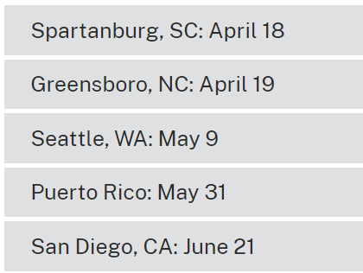
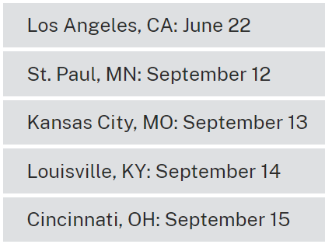
https://www.trade.gov/building-bridges-global-markets
Commercial Service
Presented Events
Building Bridges to Global Markets
The U.S. Commercial Service’s Building Bridges to Global Markets brings no-cost, in-person exporting expertise to your community. Addressing issues most common to diverse businesses seeking international sales expansion, this series of events will introduce reliable contacts, accurate information, and ready-to-use resources that will place you firmly on the road to exporting success.

Slide 11


GDEI Business Development Trade Mission to South Africa, Ghana, and Nigeria (optional)
August 6 – 15, 2023
U.S. Department of Commerce | International Trade Administration

Slide 12

Executive-Led Trade Mission
Johannesburg, Accra, and Lagos (optional)
Sectors:
Automotive
ICT
Consumer Goods
Safety & Security
Cost:
SME/Trade Associations
$3,725 South Africa and Ghana only
$5,720 South Africa, Ghana & Nigeria
Large Company
$6,520 South Africa and Ghana only
$10,300 South Africa, Ghana & Nigeria
Additional Company Participants
$800 SMEs / $1300 Large Company
(Limit 2 participants per company)
U.S. COMMERCIAL SERVICE GDEI Trade Mission to Africa
trade.gov/export-solutions

Slide 13
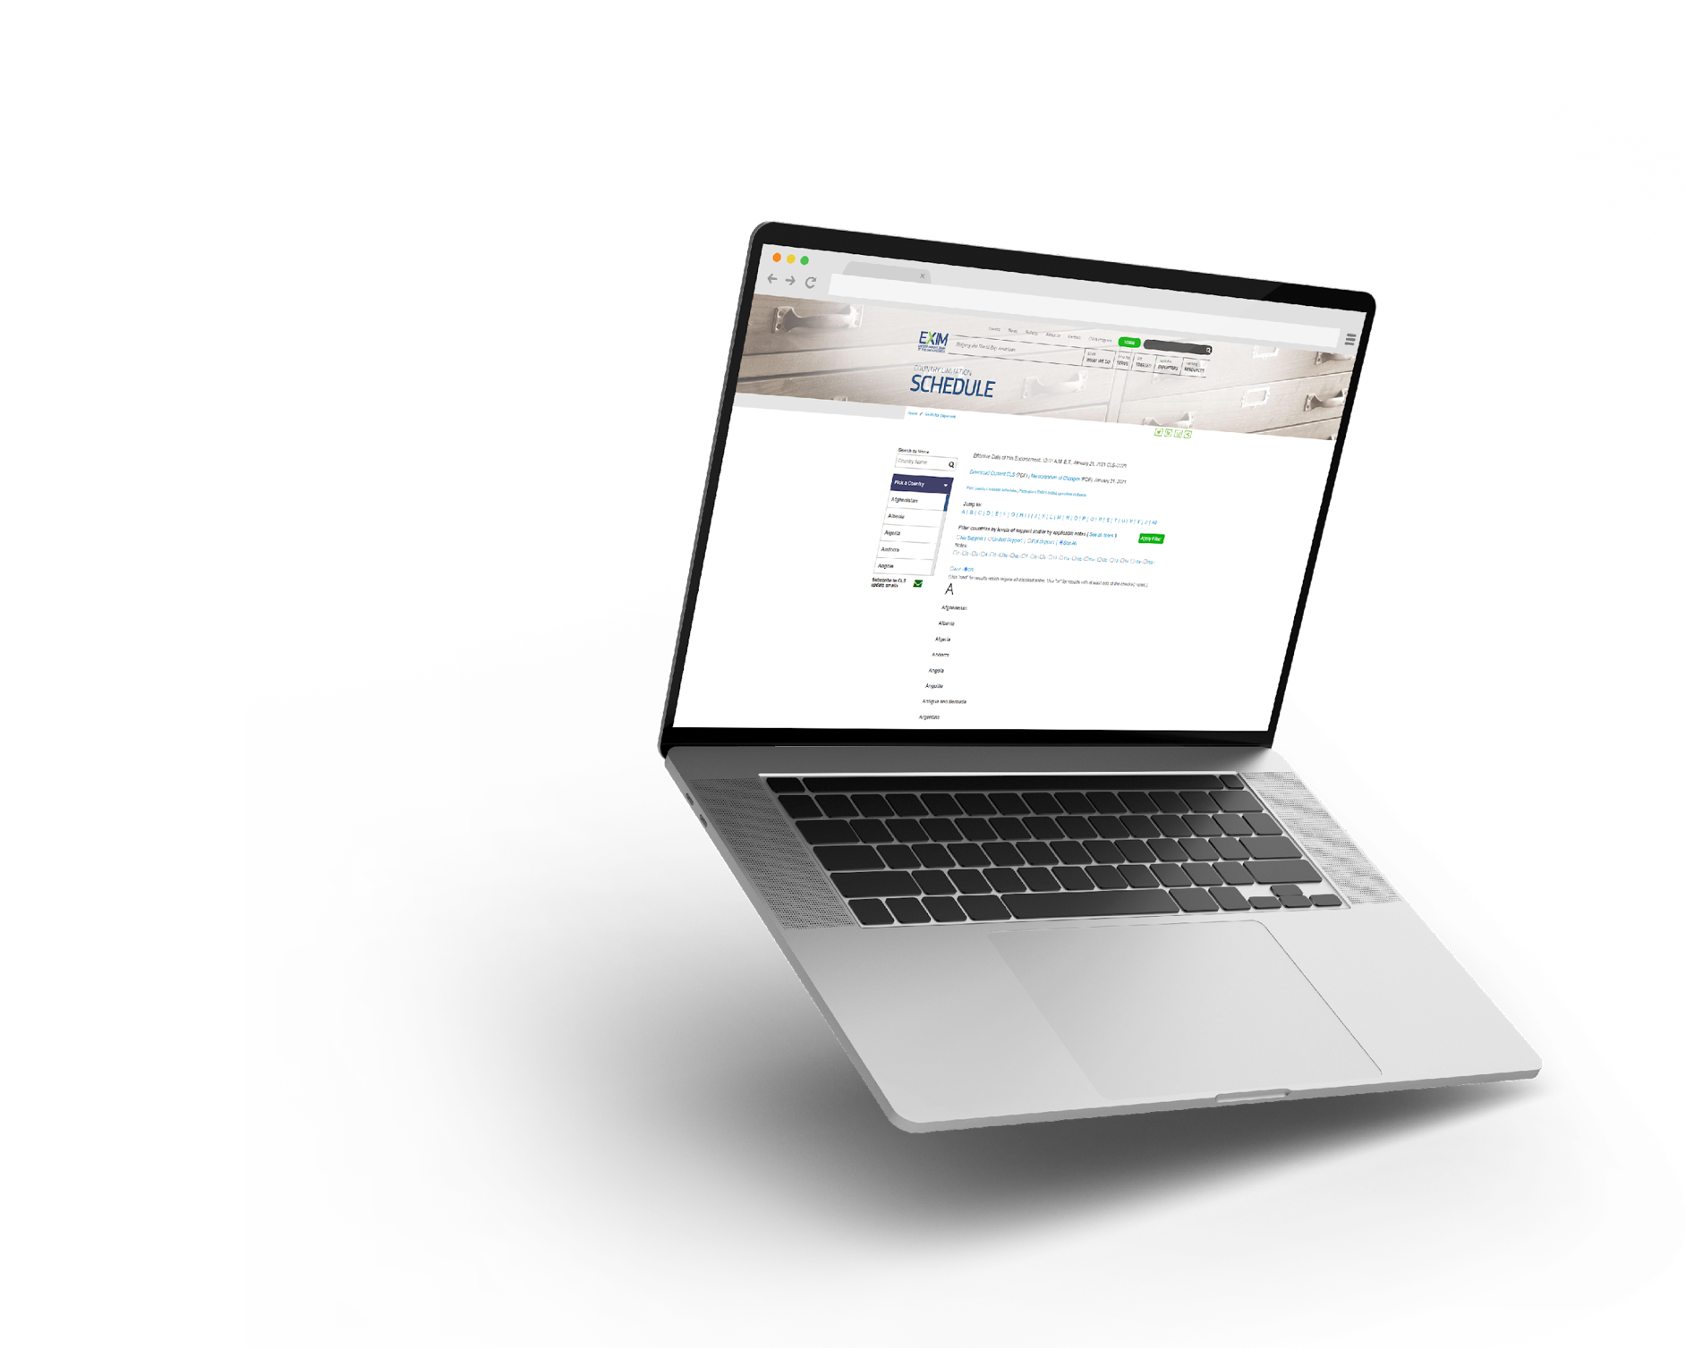

TOOLS FOR EXPORTERS
Country Limitation
Schedule
EXIM conducts business in most countries throughout the world
Restrictions may apply based on political or economic conditions and are highlighted on the Country Limitation Schedule
  Check the Country
  Limitation Schedule (CLS)
  at www.exim.gov.
Open in nearly 180 countries

Slide 14
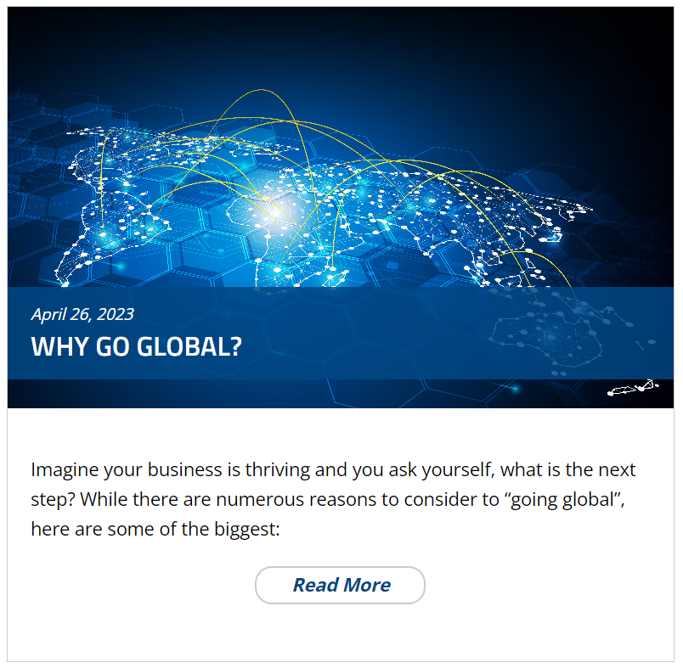
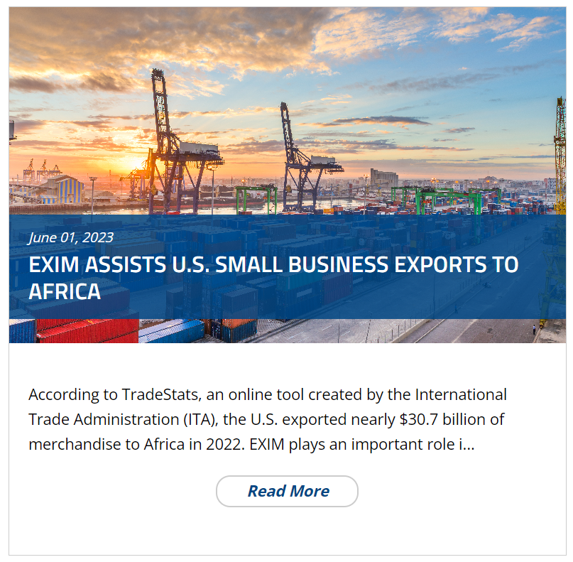
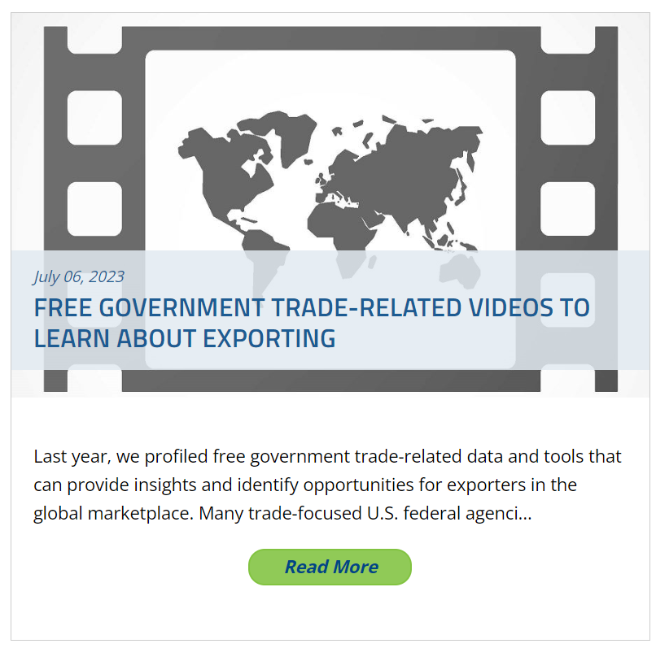
EXIM Blog
grow.exim.gov/blog

