Slide 1


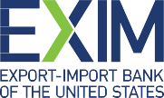
EXIM
Solutions to Support
Your Export Growth
NAME, Title

Slide 2






Who We Are
EXIM is a U.S. federal government agency
Established in 1934
Headquartered in Washington, D.C.
12 Regional Offices nationwide
Our Mission: Facilitate U.S. jobs
by supporting the growth of U.S. exports
Fills gaps and complements private-sector financing
Levels the playing field for U.S. companies
competing for global sales

Slide 3


How Can EXIM
Products Assist You?
You Need:
Funds to fulfill orders
Extension of credit
Risk protection
Access to capital
Our Solution:
Working Capital Loan Guarantee
Export Receivables Insurance

Slide 4

How Can EXIM
Products Assist You?
You Need:
Foreign Buyer Financing
On/Reshoring or Expanding Manufacturing Capacity in the US
Our Solution:
Medium and Long Term
Insurance and Loan Guarantee

Slide 5
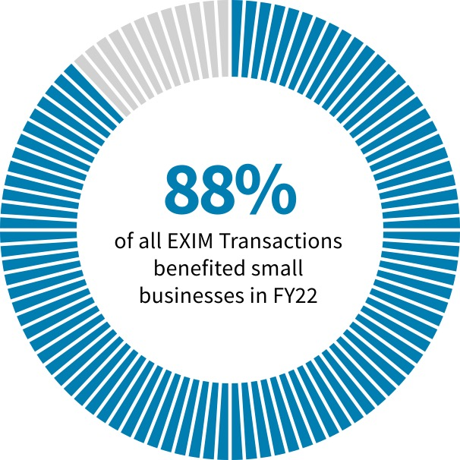
WE ARE
Small Business Focused
In FY 2022:
88% of transactions supported small businesses
54% of those transactions were < $500,000
$1.5 billion in total authorizations

Slide 6

Minority & Women-Owned Business Outreach
Audiences Served Include
Minorities
Women
Veterans
Owners with Disabilities
Native American Indians
Rural Businesses
LGBTQIA Community
Underserved Business Community
166
outreach and education
events engaging minority
and women-owned
businesses in FY2022
$347.4
million in support of
minority and
women-owned
businesses in FY2022

Slide 7


WHAT IS
Export Credit Insurance?
Export Credit Insurance is…
An insurance policy covering receivables generated from export sales that protects against nonpayment by international buyers
Export Credit Insurance enables you to…
Be competitive with open account credit terms
Use insured receivables from export sales as collateral to obtain working capital

Slide 8

Export Credit Insurance
Benefits:
Sales Tool
Allows exporter to offer competitive credit terms
to international buyers, generally up to 180 days,
some products may qualify for 360-day terms
Risk Protection
Protects against buyer nonpayment due to
commercial and political risks
Financing Aid
Obtain financing – insured export receivables
may be added to your borrowing base by assignment
of policy proceeds (claim payments) to a lender

Slide 9

WHAT IS
Working Capital Loan Guarantee?
Working Capital Loan Guarantee is…
A guarantee to a commercial lender that makes a loan to an exporter to purchase or manufacture U.S. goods for export
Exporters to unlock cash flow to fulfill sales orders and take on new business abroad.
Working Capital Loan Guarantee enables you to…
Exporters can borrow more with the same collateral, secure performance and bid bonds necessary to win projects, and increase their global competitiveness.

Slide 10
Provides a 90% guarantee of repayment
(principal and interest) on loans to exporters
May be set up as a “Transaction-specific”
or a “Revolving” line of credit
No minimum or maximum amounts
Loan supports advances made against export-related
inventory (including WIP) and foreign receivables:
  Up to 75% advance rate on inventory, and up to 90% on foreign receivables
Some buyer approval authority may be given
to exporter
Asset-Based: fully collateralized
Personal Guarantees: required of owner(s)
Working Capital
Loan Guarantee
Empowers exporters to unlock
cash flow to fulfill sales orders
and take on new business abroad

Slide 11
Medium-Term
Financing
85% financed, 15% cash down payment by the buyer
(may be financed by lender)
Repayment up to 5 years, exceptionally 7 years
Amounts of $25 million or less
Long-term financing for projects
Generally used for foreign buyer financing of capital equipment

Slide 12
Major Financing Tools
Domestic Financing
Financing to establish or expand domestic manufacturing facilities or infrastructure projects
Provided at market rates and available amount scales with number of U.S. jobs supported
Project must demonstrate that 25 percent of production or expected shipments are tied to exports
  Small businesses, transformational export area projects, and environmentally beneficial projects eligible for lower, 15 percent export nexus threshold

Slide 13

EXIM Eligible
Open for business in 180+ countries!
Final shipment takes place from a US port
All industries welcome; military & defense exports are limited

Slide 14


TOOLS FOR EXPORTERS
Country Limitation
Schedule
EXIM Bank conducts business in most countries throughout the world.
Restrictions may apply based on political or economic conditions and are highlighted on the Country Limitation Schedule.
  Check the Country
  Limitation Schedule (CLS)
  at www.exim.gov.
Open in over 180 countries

Slide 15

Eligibility Criteria
Products shipped from U.S. with more than 50% U.S. content including labor & overhead, but not mark-up.
At least 3-year operating history, a positive net worth.
A DUNS number with Dun & Bradstreet.
Obtained and maintained an active SAM.gov registration, including the issuance of a Unique Entity Identifier (UEI).
Request must be in proportion with exporter’s size.

Slide 16

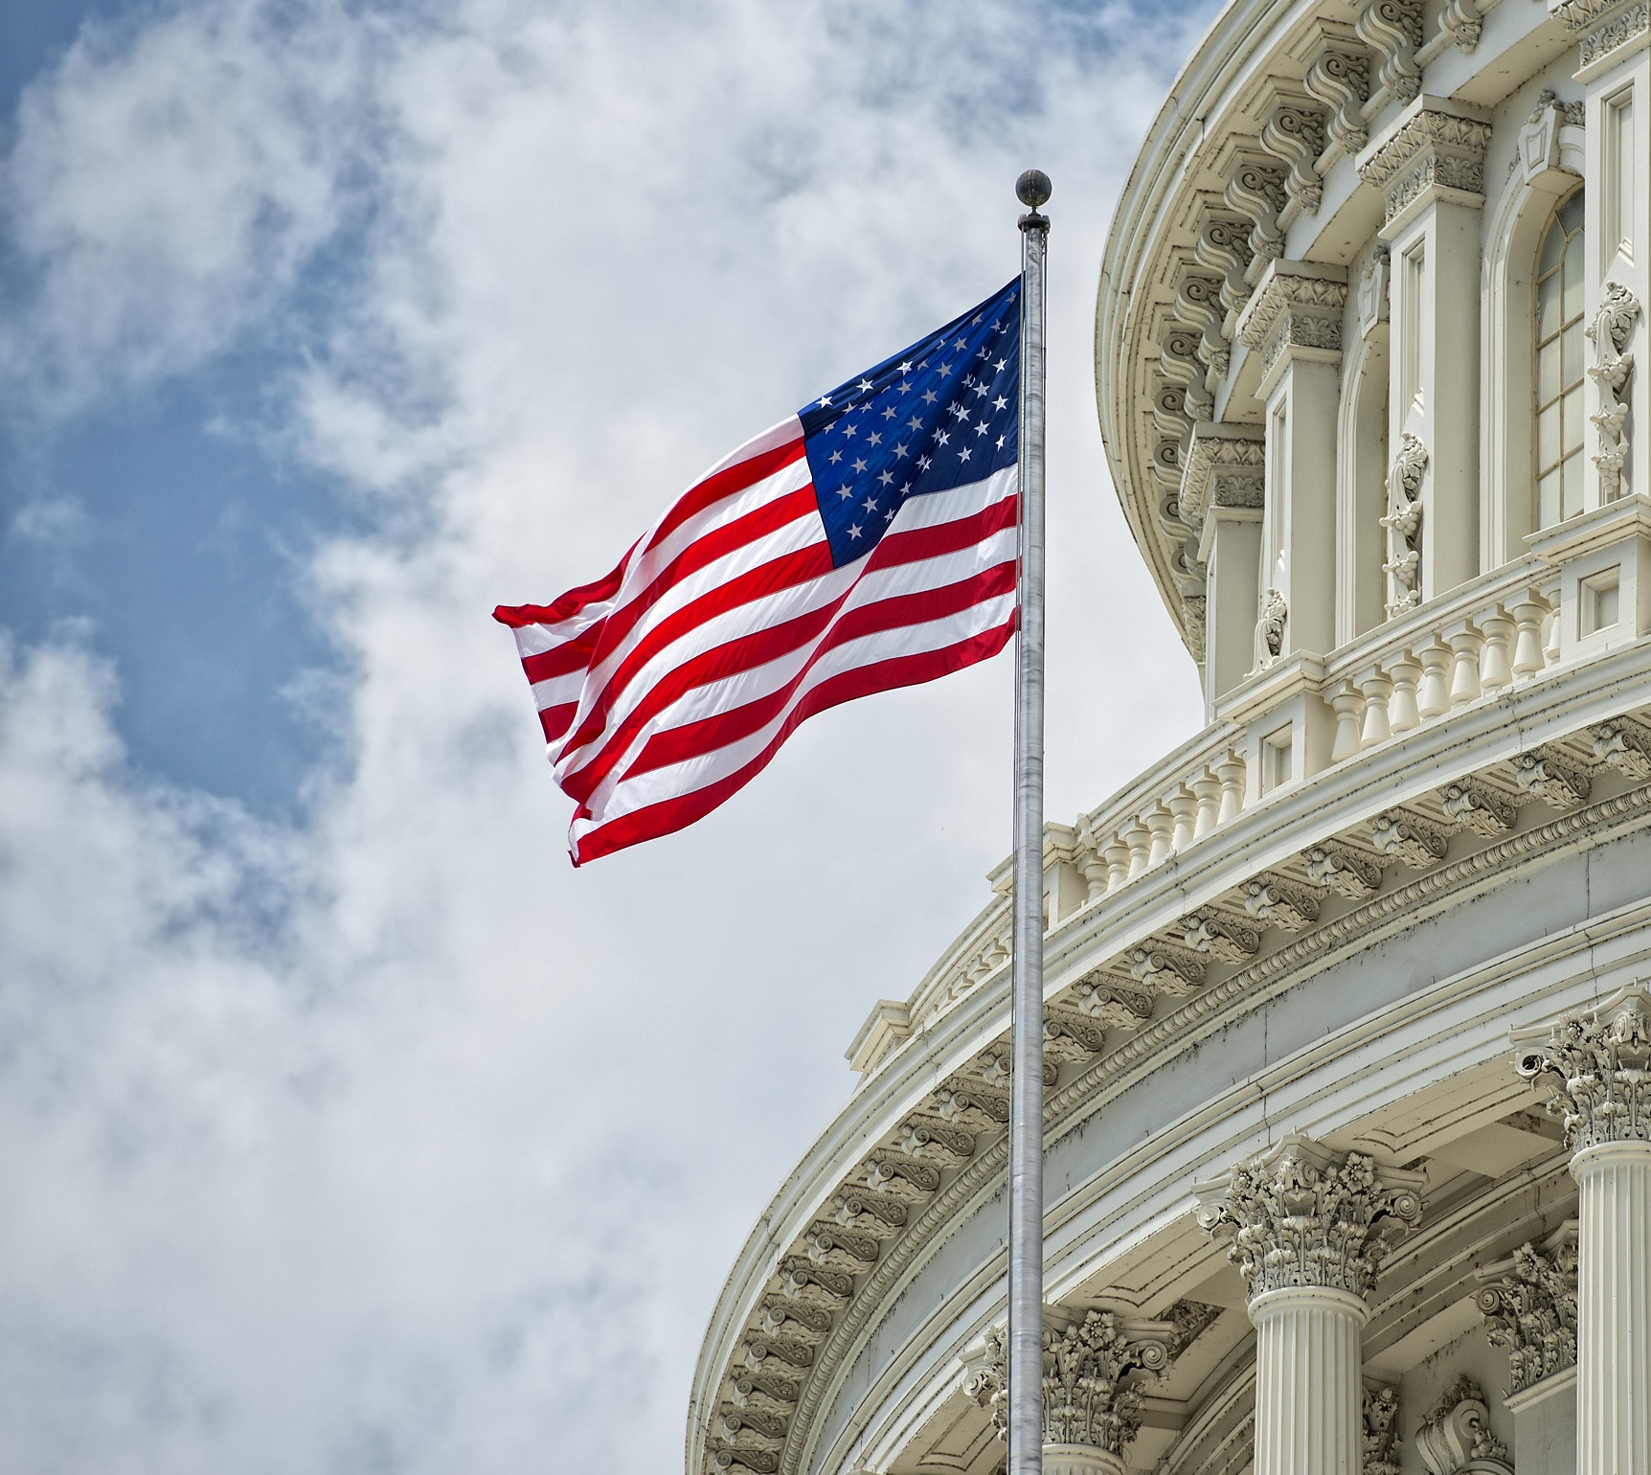
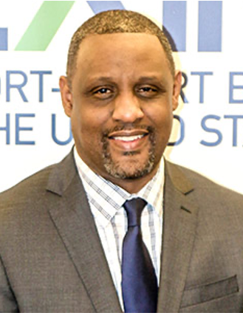
Aerek Stephens
Export Finance Manager
(205) 375-8909
aerek.stephens@exim.gov
SCHEDULE A CONSULTATION
https://grow.exim.gov/aerek-stephens

Slide 17
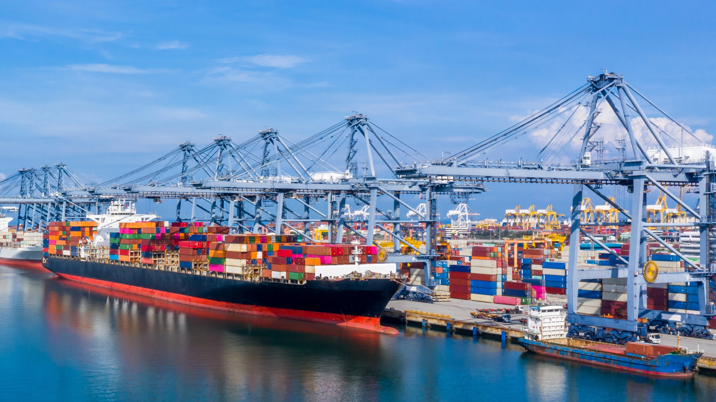
?
Questions from
the audience?

Slide 18
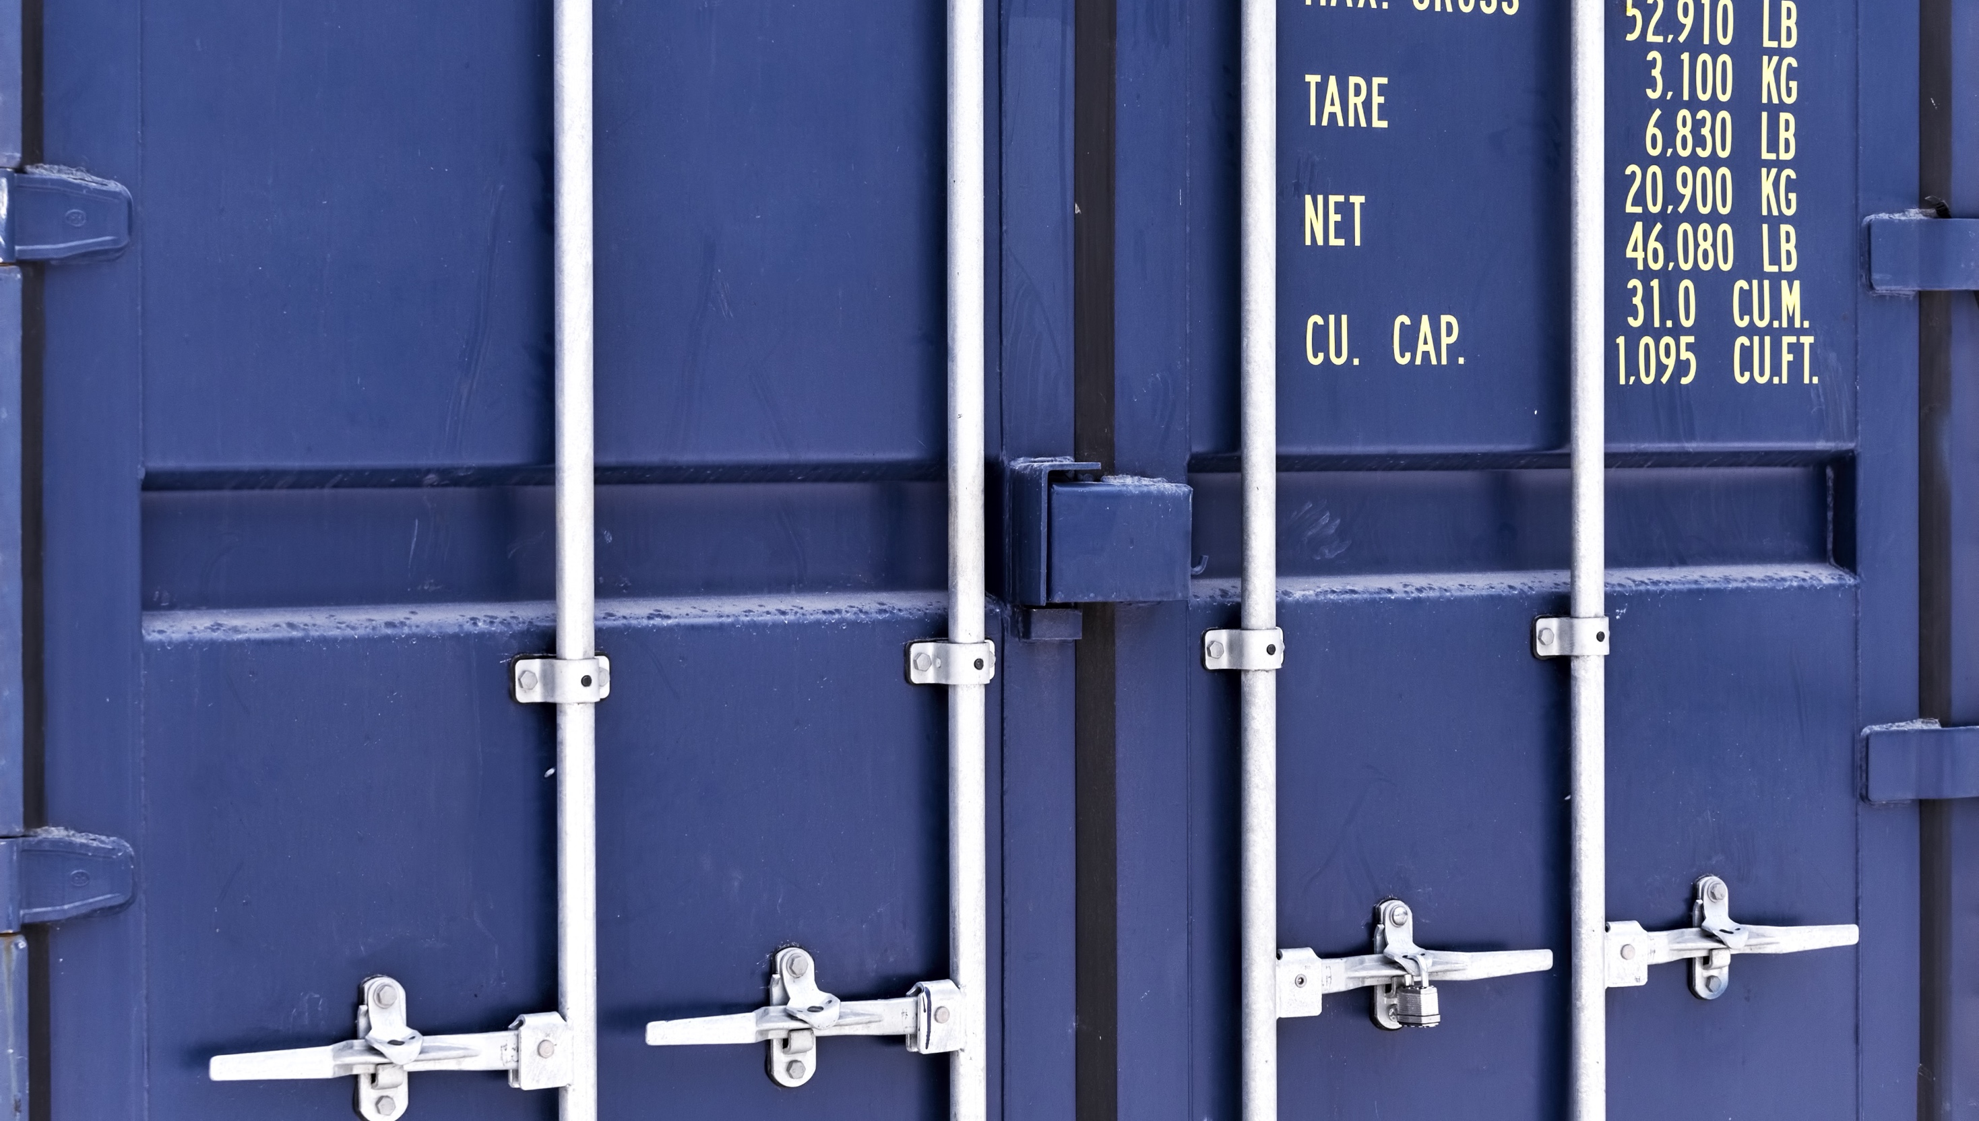
Closing Remarks

