Slide 1



EXIM
Solutions to Support
Your Export Growth
Name, Title

Slide 2






Who We Are
EXIM is a U.S. federal government agency
Established in 1934
Headquartered in Washington, D.C.
12 Regional Offices nationwide
Our Mission: Facilitate U.S. jobs
by supporting the growth of U.S. exports
Fills gaps and complements private-sector financing
Levels the playing field for U.S. companies
competing for global sales

Slide 3



WHAT WE DO
Ways EXIM Can Help
1
2
3
Improve competitiveness by insuring your receivables from international sales
Assist in obtaining
pre-export working
capital financing
Support capital equipment exports with term loans
for international buyers
Helping American Businesses
Win the Future

Slide 4


How Can EXIM
Products Assist You?
You Need:
Funds to fulfill orders
Extension of credit
Risk protection
Access to capital
Our Solution:
Working Capital Loan Guarantee
Export Receivables Insurance

Slide 5

How Can EXIM
Products Assist You?
You Need:
Foreign Buyer Financing
On/Reshoring or Expanding Manufacturing Capacity in the US
Our Solution:
Medium and Long Term
Insurance and Loan Guarantee

Slide 6
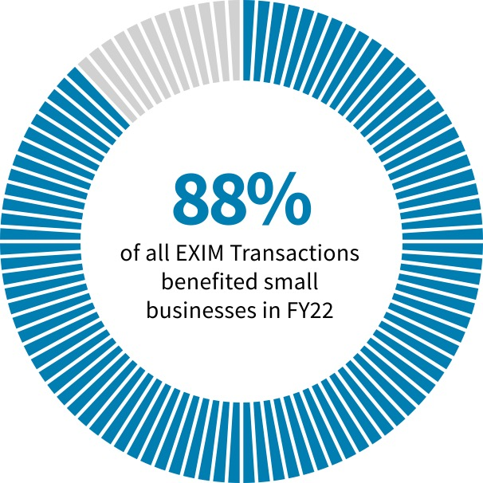
WE ARE
Small Business Focused
In FY 2022:
88% of transactions supported small businesses
54% of those transactions were < $500,000
$1.5 billion in total authorizations

Slide 7

Minority & Women-Owned Business Outreach
Audiences Served Include
Minorities
Women
Veterans
Owners with Disabilities
Native American Indians
Rural Businesses
LGBTQIA Community
Underserved Business Community
166
outreach and education
events engaging minority
and women-owned
businesses in FY2022
$347.4
million in support of
minority and
women-owned
businesses in FY2022

Slide 8



Export Challenges
Pre-export cash needed
An EXIM guaranteed credit line
provides funds to fulfill new orders
Will you get paid?
EXIM’s export credit insurance
provides payment coverage for
both commercial and political risks
Buyers want credit terms
EXIM’s export credit insurance covers the risk of open account terms
Buyers want term financing
EXIM supports financing by U.S. commercial lenders to creditworthy international buyers for capital equipment and related services

Slide 9

OUR PRODUCTS
Cover the Spectrum
Pre-Export Financing
Post-Export Financing
Working Capital
Loan Guarantee
Insurance
Guarantees
Direct Loans

Slide 10


WHAT IS
Export Credit Insurance?
Export Credit Insurance is…
An insurance policy covering receivables generated from export sales that protects against nonpayment by international buyers
Export Credit Insurance enables you to…
Be competitive with open account credit terms
Use insured receivables from export sales as collateral to obtain working capital

Slide 11

SALES TERMS AS A
Spectrum of Risk
Cash in
Advance
Letters of Credit (L/C)
Cash Against
Documents
Open
Account
SELLER RISK
Low Risk
High Risk
BUYER RISK
High Risk
Low Risk

Slide 12




How Export Credit Insurance Works
Step 1:
You identify an international buyer and obtain an Export Credit Insurance policy.
Step 5:
You report shipments and pay premiums on the amount shipped.
Step 3:
The buyer accepts
the deal’s terms.
Step 2:
Step 4:
You ship your product and invoice the buyer.
Step 6:
The buyer pays. If they fail to do so, EXIM pays.
You offer credit terms to your foreign buyer.

Slide 13

Export Credit Insurance
Benefits:
Risk Protection
Protects against buyer nonpayment due to
commercial and political risks
Sales Tool
Allows exporter to offer competitive credit terms
to foreign buyers, generally up to 180 days,
some products may qualify for 360-day terms
Financing Aid
Obtain additional financing – insured foreign receivables
may be added to your borrowing base by assignment
of policy proceeds (claim payments) to a lender

Slide 14


What is Covered?
Commercial Risks:
Political Risks:
Insolvency
Bankruptcy
Protracted Default
War, revolution, insurrection
Currency transfer risk
Cancellation of import
or export license
Disputes with the buyer are not covered

Slide 15

SHORT-TERM
Export Credit Insurance
Multi-Buyer
(entire export portfolio)
95% coverage, no deductible (for “small business” policies only), pay-as-you-go, some buyer approval authority may be given to exporter
Multi-Buyer
Select Risk
(a negotiated portfolio)
95% coverage, first-loss deductible, pay-as-you-go, some buyer approval authority may be given
to exporter
Single-Buyer
(single or multiple
shipments to one buyer)
90% coverage, no deductible
FOR EXPORTERS

Slide 16

WHAT IS
Working Capital Loan Guarantee?
Working Capital Loan Guarantee is…
A guarantee to a commercial lender that makes a loan to an exporter to purchase or manufacture U.S. goods for export
Exporters to unlock cash flow to fulfill sales orders and take on new business abroad.
Working Capital Loan Guarantee enables you to…
Exporters can borrow more with the same collateral, secure performance and bid bonds necessary to win projects, and increase their global competitiveness.

Slide 17
Provides a 90% guarantee of repayment
(principal and interest) on loans to exporters
May be set up as a “Transaction-specific”
or a “Revolving” line of credit
No minimum or maximum amounts
Loan supports advances made against export-related
inventory (including WIP) and foreign receivables:
  Up to 75% advance rate on inventory, and up to 90% on foreign receivables
Some buyer approval authority may be given
to exporter
Asset-Based: fully collateralized
Personal Guarantees: required of owner(s)
Working Capital
Loan Guarantee
Empowers exporters to unlock
cash flow to fulfill sales orders
and take on new business abroad

Slide 18

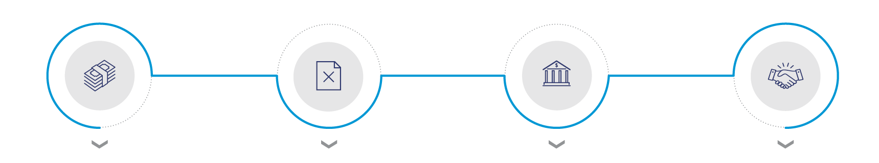
How The Working Capital
Loan Guarantee Works
Step 1:
Step 2:
Step 3:
Step 4:
You export and want to
grow export sales,
but need to finance export accounts receivable
and inventory destined
for export.
You apply for a working
capital loan, but your lender won’t approve it because your collateral
is export-related.
Lenders with delegated
authority process your working capital loan under established EXIM criteria.
Your lender loans you the money. You use the funds to fulfill your export sale.

Slide 19
Working Capital
Loan Guarantee
Working Capital Facility
Without EXIM Bank
Working Capital With EXIM Bank
Advance
Rate
Borrowing
Base
Advance
Rate
Borrowing
Base
Collateral (Inventory)
Amount
Raw Materials
$200,000
20%
$40,000
75%
$150,000
Export
Inventory
WIP
$200,000
0%
0
75%
$150,000
Finished Goods
$600,000
50%
$300,000
75%
$450,000
Open Account/Foreign Account Receivable
Export/Foreign
Accounts
Receivable
$400,000
0%
0
90%
$360,000
L/C Backed A/R
$600,000
70%
$420,000
90%
$540,000
Total Borrowing Base
$760,000
vs.
$1,650,000

Slide 20
Medium-Term
Financing
85% financed, 15% cash down payment by the buyer
(may be financed by lender)
Repayment up to 5 years, exceptionally 7 years
Amounts of $25 million or less
Long-term financing for projects
Generally used for foreign buyer financing of capital equipment

Slide 21
Major Financing Tools
Domestic Financing
Financing to establish or expand domestic manufacturing facilities or infrastructure projects
Provided at market rates and available amount scales with number of U.S. jobs supported
Project must demonstrate that 25 percent of production or expected shipments are tied to exports
  Small businesses, transformational export area projects, and environmentally beneficial projects eligible for lower, 15 percent export nexus threshold

Slide 22

EXIM Eligible
Open for business in 180+ countries!
Final shipment takes place from a US port
All industries welcome; military & defense exports are limited

Slide 23


TOOLS FOR EXPORTERS
Country Limitation
Schedule
EXIM Bank conducts business in most countries throughout the world.
Restrictions may apply based on political or economic conditions and are highlighted on the Country Limitation Schedule.
  Check the Country
  Limitation Schedule (CLS)
  at www.exim.gov.
Open in over 180 countries

Slide 24

Eligibility Criteria
Products shipped from U.S. with more than 50% U.S. content including labor & overhead, but not mark-up.
At least 3-year operating history, a positive net worth.
A DUNS number with Dun & Bradstreet.
Obtained and maintained an active SAM.gov registration, including the issuance of a Unique Entity Identifier (UEI).
Request must be in proportion with exporter’s size.

Slide 25



Aerek Stephens
Export Finance Manager
(205) 375-8909
aerek.stephens@exim.gov
SCHEDULE A CONSULTATION
https://grow.exim.gov/aerek-stephens

Slide 26

?
Questions from
the audience?

Slide 27
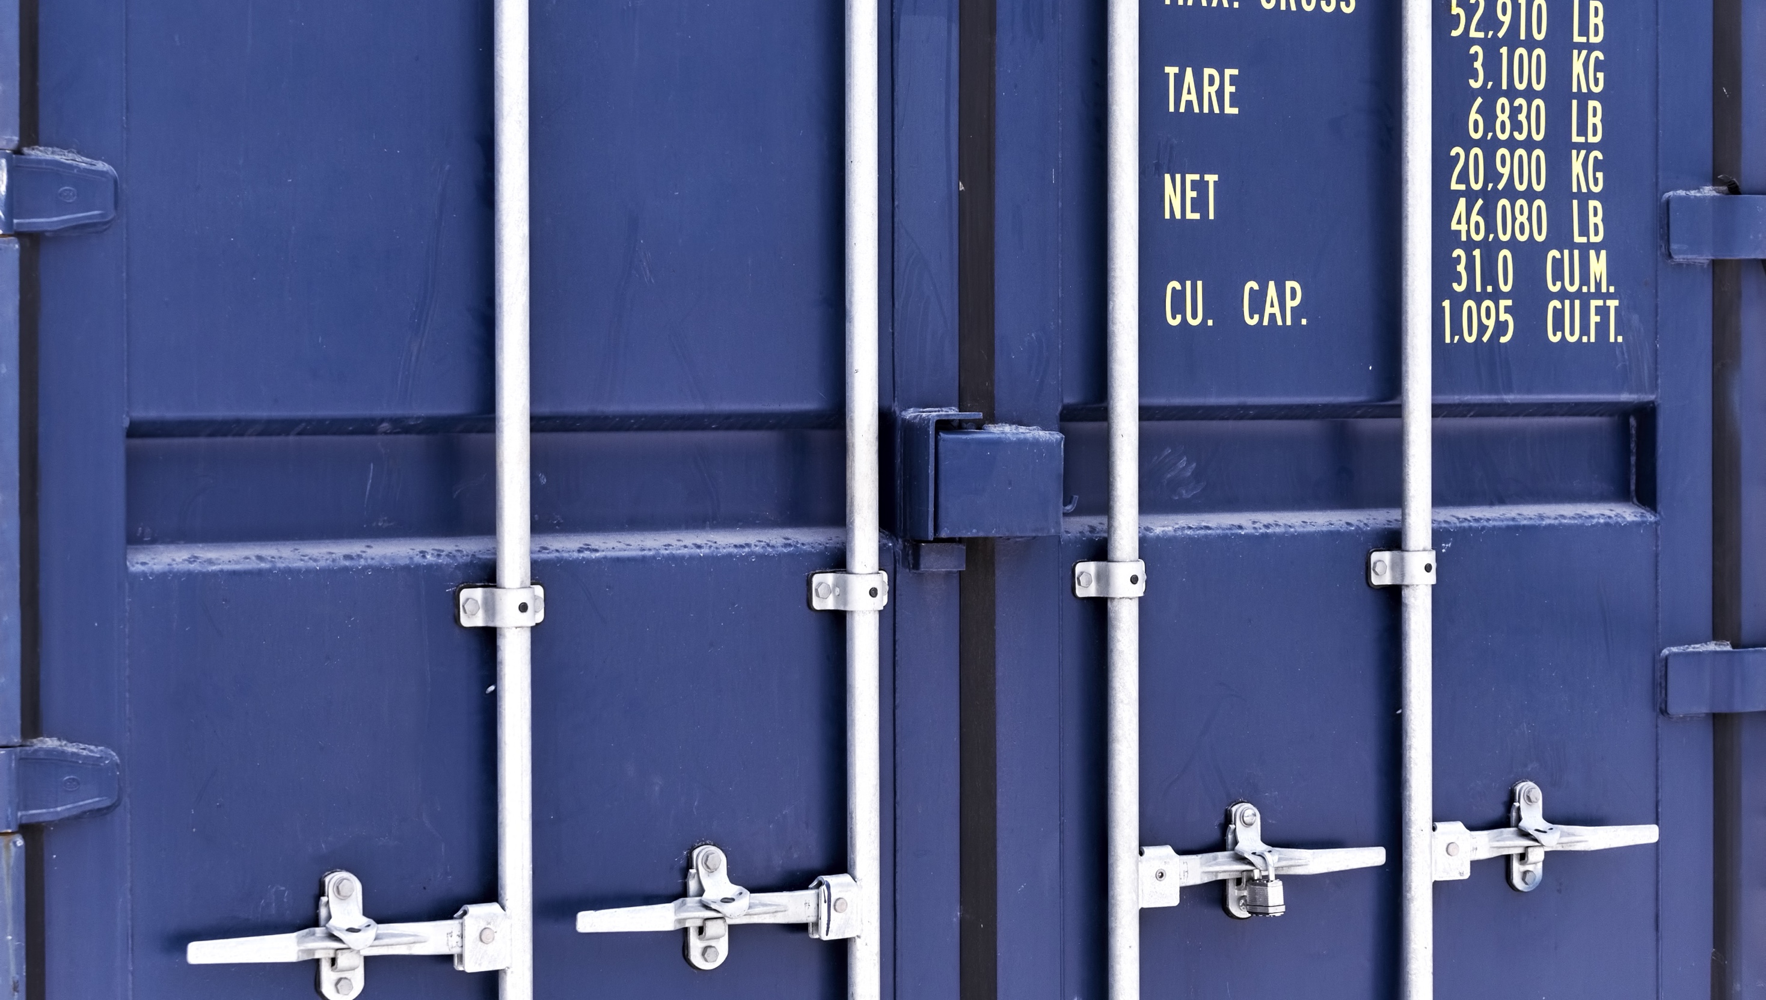
Closing Remarks

