Slide 1



EXIM
Solutions to Support
Your Export Growth
Presenter Name, Title

Slide 2






Who We Are
EXIM is a U.S. federal government agency
Established in 1934
Headquartered in Washington, D.C.
12 Regional Offices nationwide
Our Mission: Facilitate U.S. jobs
by supporting the growth of U.S. exports
Fills gaps and complements private-sector financing
Levels the playing field for U.S. companies
competing for global sales

Slide 3



WHAT WE DO
Ways EXIM Can Help
1
2
3
Improve competitiveness by insuring your receivables from international sales
Assist in obtaining
pre-export working
capital financing
Support capital equipment exports with term loans
for international buyers
Helping American Businesses
Win the Future

Slide 4


How Can EXIM
Products Assist You?
You Need:
Funds to fulfill orders
Extension of credit
Risk protection
Access to capital
Our Solution:
Working Capital Loan Guarantee
Export Receivables Insurance

Slide 5

How Can EXIM
Products Assist You?
You Need:
Foreign Buyer Financing
On/Reshoring or Expanding Manufacturing Capacity in the US
Our Solution:
Medium and Long Term
Insurance and Loan Guarantee

Slide 6
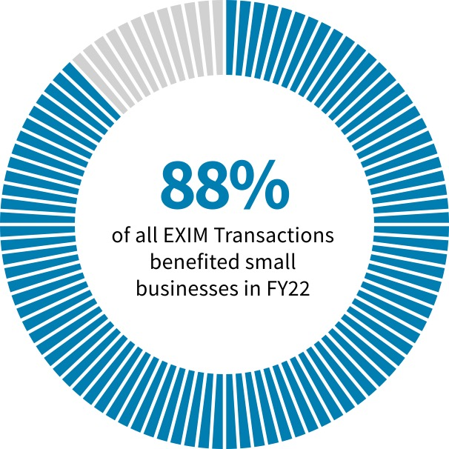
WE ARE
Small Business Focused
In FY 2022:
88% of transactions supported small businesses
54% of those transactions were < $500,000
$1.5 billion in total authorizations

Slide 7





OUR FINANCING
Makes the Difference
Level the playing field
and compete globally
Minimize the risk
of buyer non-payment
Supplement
commercial financing
No company or transaction is too small
EXIM has supported sales of just a few thousand dollars

Slide 8

Minority & Women-Owned Business Outreach
Audiences Served Include
Minorities
Women
Veterans
Owners with Disabilities
Native American Indians
Rural Businesses
LGBTQIA Community
Underserved Business Community
166
outreach and education
events engaging minority
and women-owned
businesses in FY2022
$347.4
million in support of
minority and
women-owned
businesses in FY2022

Slide 9

Why Export?
95% of the world’s buying power is outside of the United States
Companies that export are more profitable*
Minority-owned businesses are uniquely qualified
and connected to overseas markets
*U.S. Commercial Service Basic Guide to Exporting

Slide 10


Why Do Only 1% of Companies Export?
Fear of the unknown…RISK!

Slide 11

Exporting Myths
My domestic sales are strong,
I don’t need to export
Market stability can fluctuate,
global sales promote long-term success
Exporting is too risky – what if
I don’t get paid?
EXIM offers solutions that
protect against nonpayment
by international buyers
1
3
2
4
My business is too small
42% of small business exporters have fewer than 19 employees
Getting started is difficult
Call us — we’ll help you get started

Slide 12



Export Challenges
Pre-export cash needed
An EXIM guaranteed credit line
provides funds to fulfill new orders
Will you get paid?
EXIM’s export credit insurance
provides payment coverage for
both commercial and political risks
Buyers want credit terms
EXIM’s export credit insurance covers the risk of open account terms
Buyers want term financing
EXIM supports financing by U.S. commercial lenders to creditworthy international buyers for capital equipment and related services

Slide 13

OUR PRODUCTS
Cover the Spectrum
Pre-Export Financing
Post-Export Financing
Working Capital
Loan Guarantee
Insurance
Guarantees
Direct Loans

Slide 14

SALES TERMS AS A
Spectrum of Risk
Cash in
Advance
Letters of Credit (L/C)
Cash Against
Documents
Open
Account
SELLER RISK
Low Risk
High Risk
BUYER RISK
High Risk
Low Risk

Slide 15

WHAT IS
Export Credit Insurance?
Export Credit Insurance is…
An insurance policy covering receivables generated from export sales that protects against nonpayment by international buyers
Export Credit Insurance enables you to…
Be competitive with open account credit terms
Use insured receivables from export sales as collateral to obtain working capital

Slide 16




How Export Credit Insurance Works
Step 1:
You identify an international buyer and obtain an Export Credit Insurance policy.
Step 5:
You report shipments and pay premiums on the amount shipped.
Step 3:
The buyer accepts
the deal’s terms.
Step 2:
Step 4:
You ship your product and invoice the buyer.
Step 6:
The buyer pays. If they fail to do so, EXIM pays.
You offer credit terms to your foreign buyer.

Slide 17

Export Credit Insurance
Benefits:
Sales Tool
Allows exporter to offer competitive credit terms
to international buyers, generally up to 180 days,
some products may qualify for 360-day terms
Risk Protection
Protects against buyer nonpayment due to
commercial and political risks
Financing Aid
Obtain financing – insured export receivables
may be added to your borrowing base by assignment
of policy proceeds (claim payments) to a lender

Slide 18


What is Covered?
Commercial Risks:
Political Risks:
Insolvency
Bankruptcy
Protracted Default
War, revolution, insurrection
Currency transfer risk
Cancellation of import
or export license
Disputes with the buyer are not covered

Slide 19
Coverage Parameters
Up to 180 days, exceptionally 1 year
95%, 98% or 100% coverage, depending on policy selected, products exported, and buyer classification
Insures both commercial and political risks
Lender Policies
Bank Letter of Credit
Financial Institution Buyer Credit
Export Policy Options
Multi-Buyer, Single-Buyer, Multi-Buyer Select Risk (MBSR)
Short-Term
Export Credit
Insurance
Short-term policies have a duration of 12 months or less and involve exports of consumer goods, raw materials, spare parts, commodities, and capital equipment

Slide 20
EXPORTER-HELD
Policy Types
Multi-Buyer:
95% Coverage
Portfolio Coverage
(1) Standard (2) Small Business (3) Select Risk
Express (Small Business):
95% Coverage
(Limited portfolio; up to 10 buyers)
Complimentary
Credit Reports
Buyer
1
Buyer
2
Buyer
…
Single Buyer
90% Coverage
(One policy per buyer – country risk)
Buyer
1
Buyer
2
Buyer
3
Buyer
4
Note: Bulk Agricultural Commodities can be considered for 98% coverage

Slide 21

SMALL BUSINESS MULTI-BUYER POLICY
Key Features
95% coverage for non-payment due to commercial
and political risks
Exporter must qualify as “small business” by SBA definition,
and export credit sales must average $10 million or less
on average over the most recent 3 years
In same line of business for at least 3 years
(No material adverse issues)
Must insure all export credit sales
(L/C, CIA, CAD, SDDP, and Canadian sales may be excluded)
No deductible, no application fee, pay-as-you-go.
Buyer credit limits endorsed to policy (requires minimal
pre-approvals by EXIM)

Slide 22
Coverage Details:
95% coverage. Insuring all accounts is optional
No discretionary credit limit, EXIM reviews and makes credit decisions on all buyers
No deductible, no application fee
Policy Issuance Fee: $500 (refundable)
Small Business
Express
Insurance
Rates per $100*:
Same rates for any country risk. Based on the length
of the credit term offered to buyers.
1-60 days: $0.65
61-120 days: $1.06
121-180 days: $1.35
For small businesses new to exporting with:
≤$10 million export credit sales
10 or fewer buyers
no more than five years of export credit experience
*For private sector buyers

Slide 23

SMALL BUSINESS EXPRESS INSURANCE
Key Features
95% coverage for non-payment due to commercial
and political risks
EXIM pre-approves all credit limits and obtains credit information on your buyers at no cost to you
Generally, 5-day approval on credit limits of $300,000 or less
No minimum sales volume required; pay only on the gross invoice value of what you ship, when you ship
If insurance is combined with a working capital guarantee
from either EXIM or the SBA, there is a 25% discount on premiums

Slide 24
Coverage Details:
90% coverage, both commercial and political
  98% for bulk agricultural transactions
  95% for letter of credit transaction
EXIM approves the buyer
No deductible, no application fee
Maximum policy period: 1 year
Pay-as-you-go premiums
  Premium based on country, type or buyer, and length of credit term extended (see next slide for sample)
$500 minimum premium for first policy
Short-Term
Single-Buyer
Insurance Policy
Insures single or multiple shipments
to one buyer

Slide 25



Underwriting
Standards:
Buyer
Credit Information
_{Buyers Credit Limit} Credit Trade Bank Financial Report Reference Reference Statements Up to $100,000
$100,001 - $500,000
$500,001 - $1,000,000
$500,001 - $1,000,000
_{Buyers Credit Limit} Credit Trade Bank Financial
Report Reference Reference Statements
Foreign Buyer
*Note: Snapshot in time; Assuming Net 30,
buyer pays approx. 30 slow, can ship 5+ times
a year. One trade reference can support
over half million in annualized sales.
EXIM Bank’s Short-Term Credit Standards are available at: www.exim.gov/tools-for-exporters/credit-standards

Slide 26


EXPORT CREDIT INSURANCE
Specialist Brokers
EXIM…
Works with independent insurance brokers who assist with applications, place exporters with the best insurance option, and provide ongoing support and expertise

Slide 27


CASE STUDY:
Single-Buyer
Insurance Policy
(ESS)
Exporter has 12 active policies with EXIM,
covering foreign buyers in: Asia, Middle East,
South America, Europe, and Mexico
Policies range from $50,000 credit approval,
to $600,000, per buyer
Average policy cost 0.84% x sales (or $840
to insure $100,000 in monthly sales)
Uses private insurance as their main coverage,
only supplementing with EXIM as needed
Oregon company who
stone-grinds whole grains
into over 400 end-products

Slide 28

WHAT IS
Working Capital Loan Guarantee?
Working Capital Loan Guarantee is…
A guarantee to a commercial lender that makes a loan to an exporter to purchase or manufacture U.S. goods for export
Unlock cash flow to fulfill sales orders and take on new business abroad
Working Capital Loan Guarantee enables you to…
Borrow more with the same collateral, secure performance and bid bonds necessary to win projects, and increase global competitiveness

Slide 29
Provides a 90% guarantee of repayment
(principal and interest) on loans to exporters
May be set up as a “Transaction-specific”
or a “Revolving” line of credit
No minimum or maximum amounts
Loan supports advances made against export-related
inventory (including WIP) and foreign receivables:
  Up to 75% advance rate on inventory, and up to 90% on foreign receivables
Some buyer approval authority may be given
to exporter
Asset-Based: fully collateralized
Personal Guarantees: required of owner(s)
Working Capital
Loan Guarantee
Empowers exporters to unlock
cash flow to fulfill sales orders
and take on new business abroad

Slide 30

Working Capital
Loan Guarantee
Benefits:
Unlock Cash Flow
Pay for materials, equipment, supplies, labor, and other inputs
needed to fulfill export orders
Protect Against Risk
Provides 90% guarantee of repayment to the lender
Access More Funds
More attractive advance rates than conventional financing

Slide 31

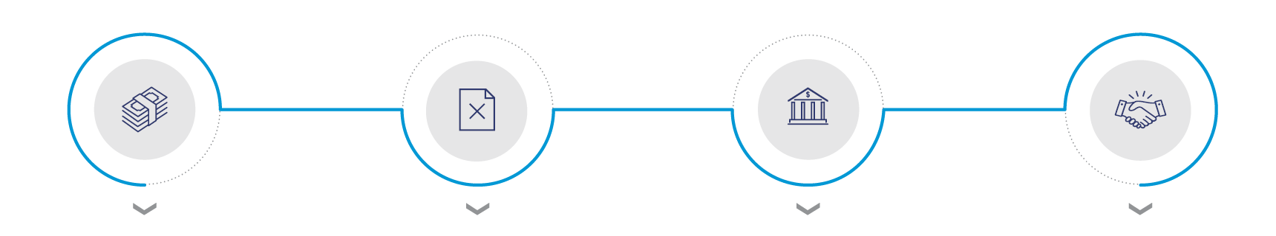
How The Working Capital
Loan Guarantee Works
Step 1:
Step 2:
Step 3:
Step 4:
You export and want to
grow export sales,
but need to finance export accounts receivable
and inventory destined
for export.
You apply for a working
capital loan, but your lender won’t approve it because your collateral
is export-related.
Lenders with delegated
authority process your working capital loan under established EXIM criteria.
Your lender loans you the money. You use the funds to fulfill your export sale.

Slide 32
Working Capital
Loan Guarantee
Working Capital Facility
Without EXIM Bank
Working Capital With EXIM Bank
Advance
Rate
Borrowing
Base
Advance
Rate
Borrowing
Base
Collateral (Inventory)
Amount
Raw Materials
$200,000
20%
$40,000
75%
$150,000
Export
Inventory
WIP
$200,000
0%
0
75%
$150,000
Finished Goods
$600,000
50%
$300,000
75%
$450,000
Open Account/Foreign Account Receivable
Export/Foreign
Accounts
Receivable
$400,000
0%
0
90%
$360,000
L/C Backed A/R
$600,000
70%
$420,000
90%
$540,000
Total Borrowing Base
$760,000
vs.
$1,650,000

Slide 33
Medium-Term
Financing
85% financed, 15% cash down payment by the buyer
(may be financed by lender)
Repayment up to 5 years, exceptionally 7 years
Amounts of $25 million or less
Long-term financing for projects
Generally used for foreign buyer financing of capital equipment

Slide 34
Major Financing Tools
Domestic Financing
Financing to establish or expand domestic manufacturing facilities or infrastructure projects
Provided at market rates and available amount scales with number of U.S. jobs supported
Project must demonstrate that 25 percent of production or expected shipments are tied to exports
  Small businesses, transformational export area projects, and environmentally beneficial projects eligible for lower, 15 percent export nexus threshold

Slide 35
China & Transformational Exports Program
Purpose: Support the extensions of loans, guarantees, and insurance at rates and on terms that are fully competitive, to the extent practicable, with those provided by China, in order to:
Directly neutralize competing subsidies provided by China through official export credit, tied aid or blended finance, or
Advance the comparative leadership of the US with respect to China in strategic industries

Slide 36
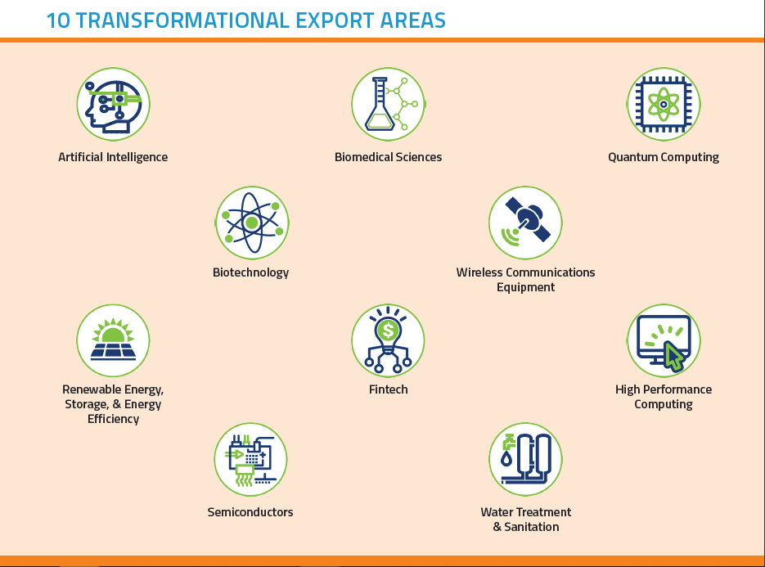

Slide 37

EXIM Eligible
Open for business in 180+ countries!
Final shipment takes place from a US port
All industries welcome; military & defense exports are limited

Slide 38
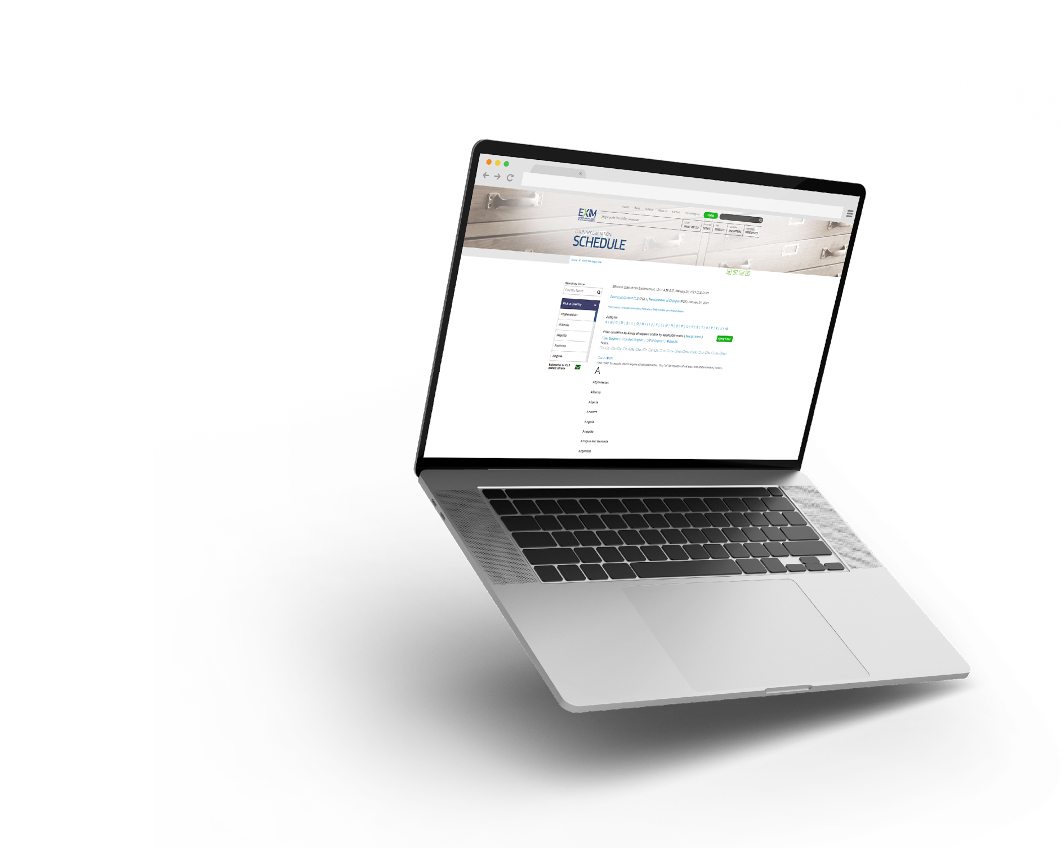
TOOLS FOR EXPORTERS
Country Limitation
Schedule
EXIM conducts business in most countries throughout the world
Restrictions may apply based on political or economic conditions and are highlighted on the Country Limitation Schedule
  Check the Country
  Limitation Schedule (CLS)
  at www.exim.gov.
Open in over 180 countries

Slide 39

Eligibility Criteria
Products shipped from U.S. with more than 50% U.S. content including labor & overhead, but not mark-up
At least 3-year operating history, a positive net worth
A DUNS number with Dun & Bradstreet
Obtain and maintain an active SAM.gov registration, including the issuance of a Unique Entity Identifier (UEI)

Slide 40


ADDITIONAL U.S FEDERAL
Government Resources
Department of Commerce
The U.S. Department of Commerce is available to help by matching American exporters with foreign buyers
Small Business Administration
Created in 1953, the U.S. Small Business Administration (SBA) continues to help small business owners and entrepreneurs pursue the American dream
Gold Key Matching Service
This service arranges meetings with interested partners in international markets. The Gold Key team first identifies foreign buyers, assesses them, and provides profiles of the best matches
Single Company Promotion
The DoC can organize a variety of promotional events to increase awareness of your company’s products and services in a specific international market
Loans
The SBA also works with lenders to guarantee loans in support of international trade
Grant Programs
The SBA also has a grant program called the State Trade Expansion Program (STEP) that provides funding to state and territory governments. These STEP funds are available to help small businesses with export development

Slide 41

ADDITIONAL EXIM
Resources & Assistance
Insurance Brokers: Broker Locator
www.exim.gov/tools-for-exporters/broker-and-lender-locator
Regional Export Promotion Program (REPP) Members: REPP Locator
www.exim.gov/tools-for-exporters/repp
Delegated Lenders: Working Capital
https://www.exim.gov/tools-for-exporters/delegated-authority-lenders

Slide 42
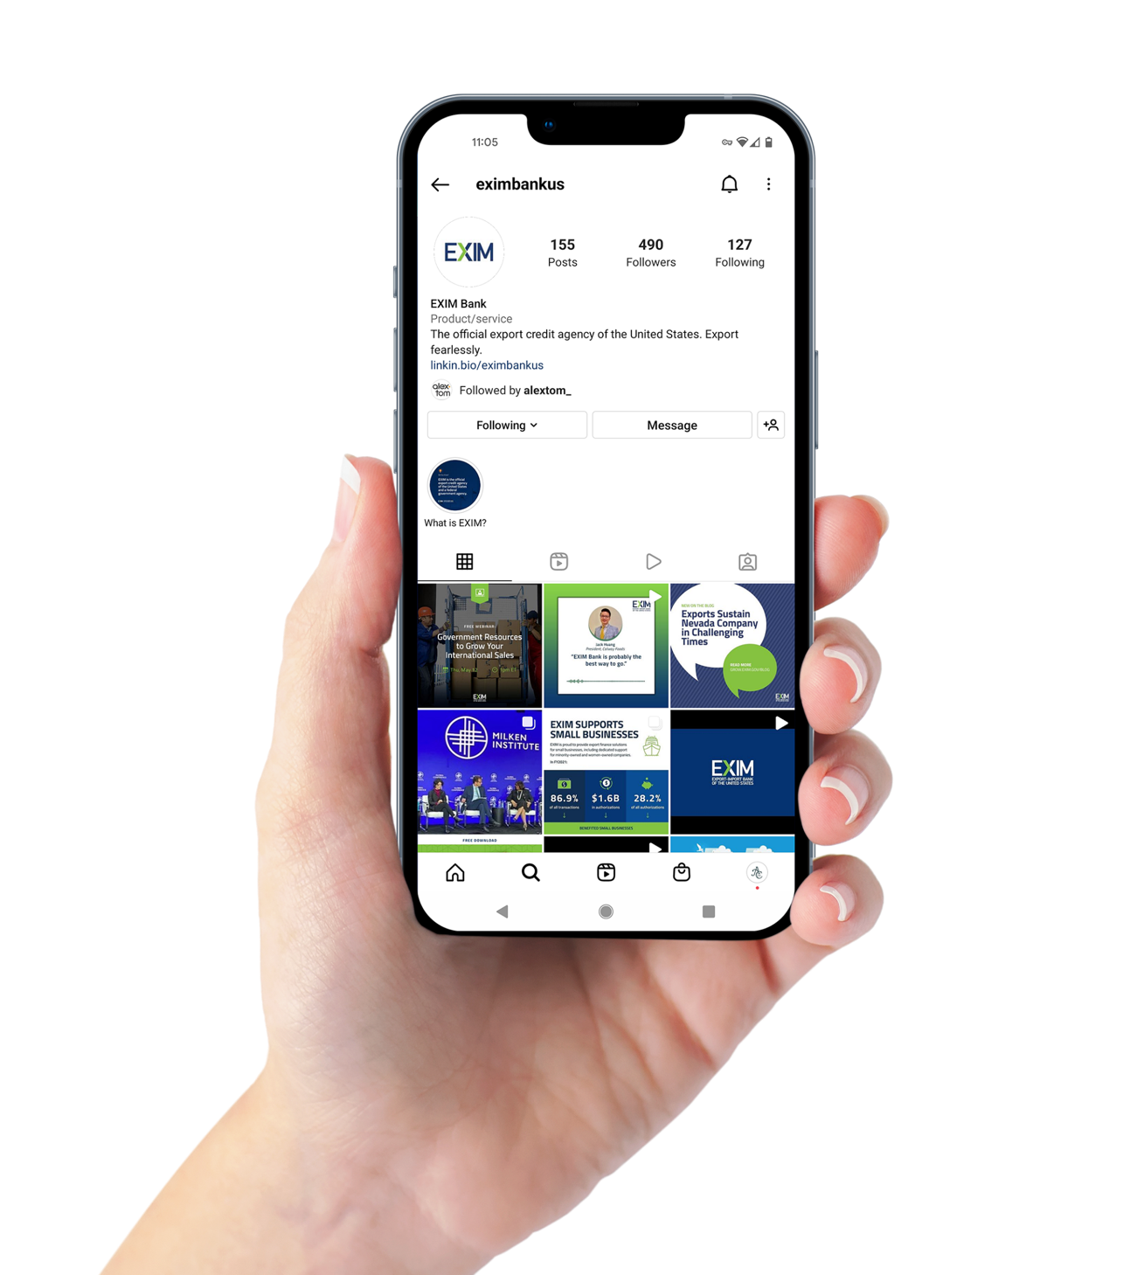





Stay Connected to EXIM
LinkedIn: https://www.linkedin.com/company/eximbankus
Twitter: https://twitter.com/eximbankus
EXIM Blog: https://grow.exim.gov/blog
Facebook: https://www.facebook.com/eximbankus
Instagram: https://www.instagram.com/eximbankus

Slide 43

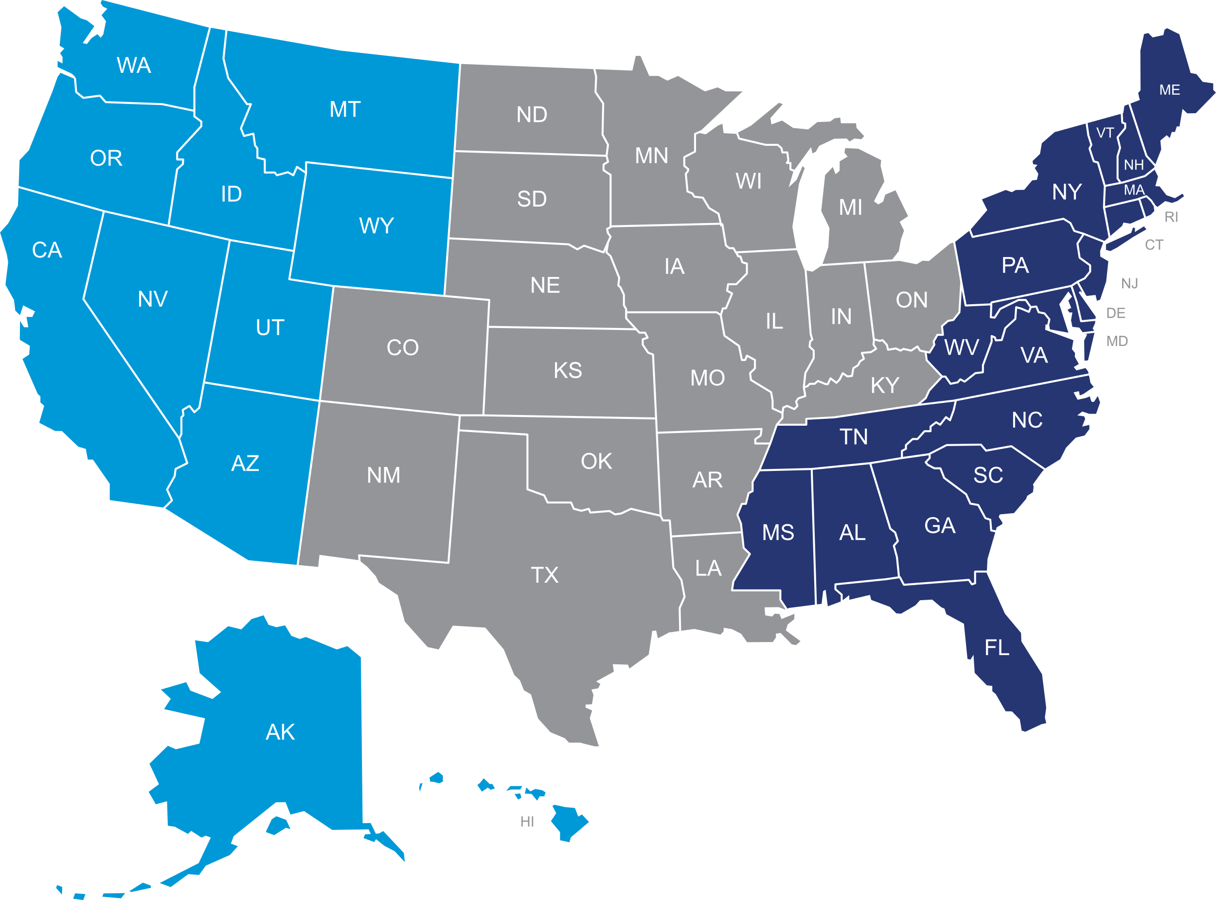
Regional Offices
EASTERN
Miami, FL: (786) 623-7673
New York, NY: (646) 499-3554
Atlanta, GA: (404) 955-2219
Washington , DC: (202) 578-5000
CENTRAL
Chicago, IL: (224) 369-4177
Houston, TX: (832) 810-6448
Minneapolis, MN: (612) 532-7947
Detroit, MI: (202) 731-2752
WESTERN
Orange County, CA: (949) 670-5394
Los Angeles, CA: (562) 213-2529
San Diego, CA: (619) 517-1822
Seattle, WA: (224) 416-3582
  Request a free consultation today at www.exim.gov.

Slide 44


Name
Title
Phone Number
Email
SCHEDULE A CONSULTATION
(Landing page URL)

Slide 45

?
Questions from
the audience?

Slide 46
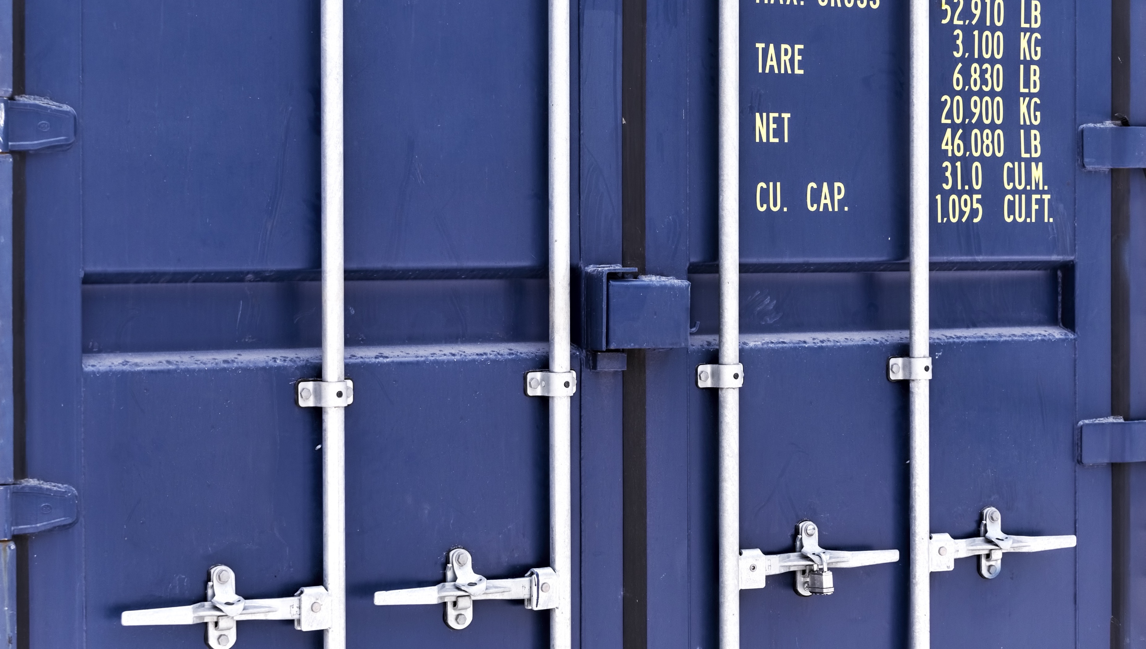
Closing Remarks

